Slide 1
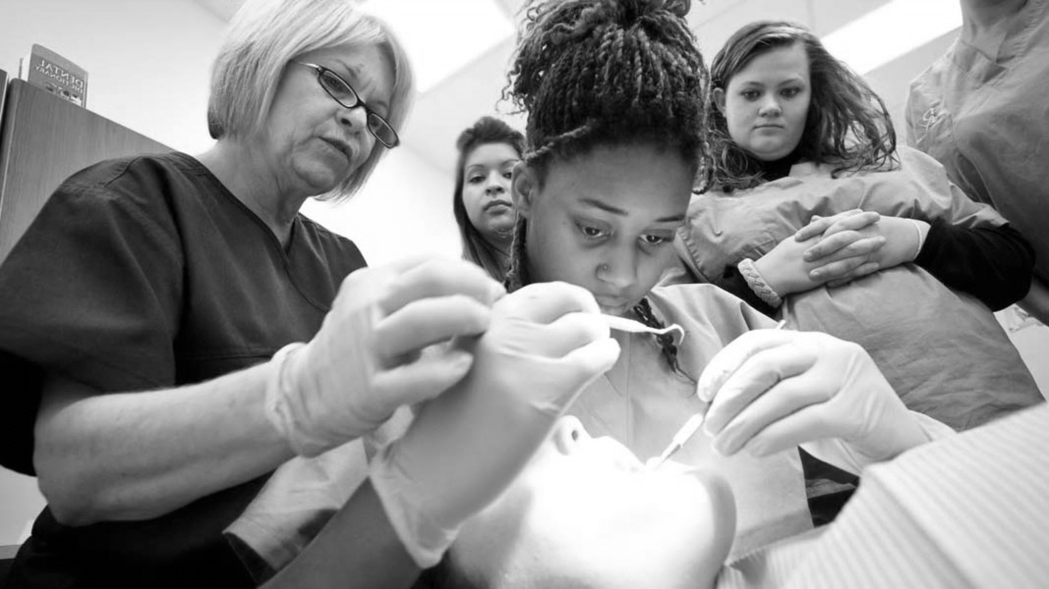

Crowns
Contents:
GDC outcomes
Aims and Objectives
Introductions
Theory
Practical Element
Further Reading

Slide 2
GDC OUTCOMES
To be able to communicate reasoning for treatment choice and possible prognosis, while obtaining valid consent ​
To work effectively with lab technician, effective communication methods to optimise results​
Understanding theory and practical elements behind the production of Crowns
A
B
C

Slide 3

AIMS AND OBJECTIVES
To understand the role of Crowns in use of modern dentistry
To understand the design aspects of Crowns
To understand material choice when requesting Crowns
To be aware of key practical aspects in cementation of Crowns
To have adequate knowledge on the literature behind the use of Crowns

Slide 4
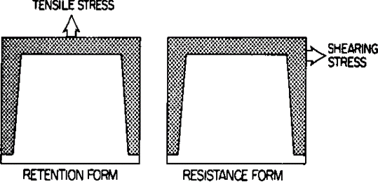
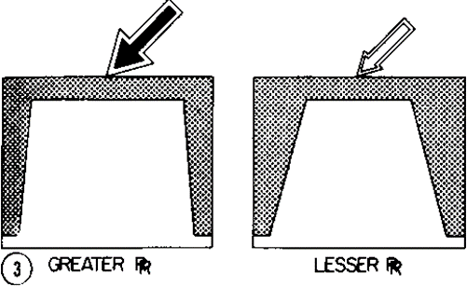
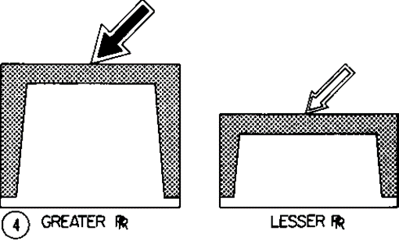
INTRODUCTION
HCrown are Full Coverage Restorations
Tooth is cut to cover all cusp and rely on mechanical retention rather than the cement
Mechanical Retention is obtained through Height and Taper of the prep design.
All Cements can be used

Slide 5
Indications
Heavily broken down tooth
Aesthetics
When conditions required for adhesive dentistry are not favorable
Congenital abnormalities where direct restorations have failed
Teeth with significant abrasion cavities
Where milled margins are required for denture rests or fixed prosthetics plan.

Slide 6
Materials
Always choose the material before cutting tooth as all have different preparation needs.
Decisions to be made:
1. Amount of tooth tissue remaining
2. Aesthetics
3. Strength (parafunction)
4. Cost
Pressed Ceramics
Leucite reinforced crowns (Empress)
Precious eg Gold
CAD-CAM
Zirconia-core
Porcelain-Fused to Metal (PFM)
Non-precious or precious core
Lithium disilicate (Emax Press)
Non-Precious metal
Alumina core
Can be made in lab or chairside
Metal
Easy to do – if you know what you’re doing!

Slide 7
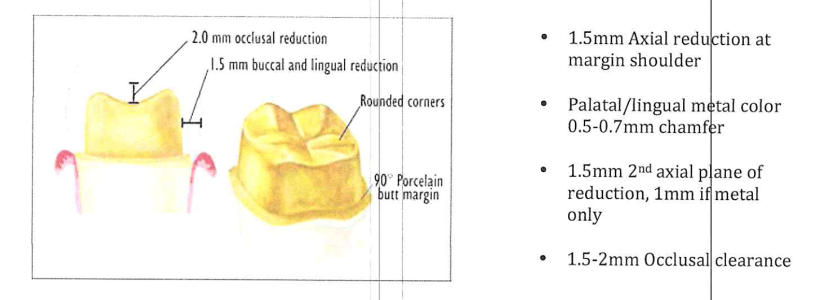
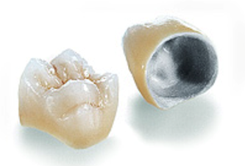
Porcelain-Fused to Metal
Most common crown in the UK
Very Aggressive Preparation
Rely completely on height and taper however can be bonded on to aid retention if lack of tooth tissue.
They are strong and have good lifespan
Useful on anterior teeth in parafunction patients can leave metal showing palatal.

Slide 8
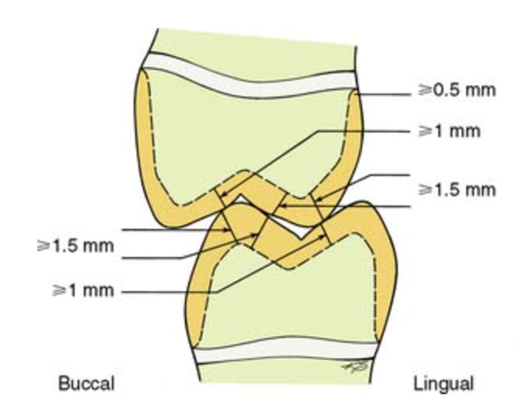
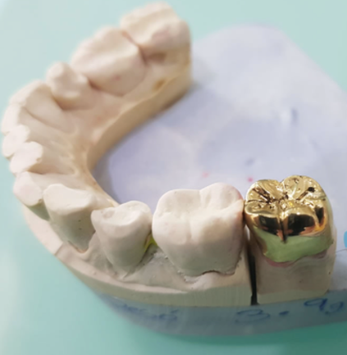
Full Gold Crown
Most conservative preparation
Most durable crown
Excellent in parafunction patients
Minimal wear on opposing teeth
Usually most expensive.

Slide 9
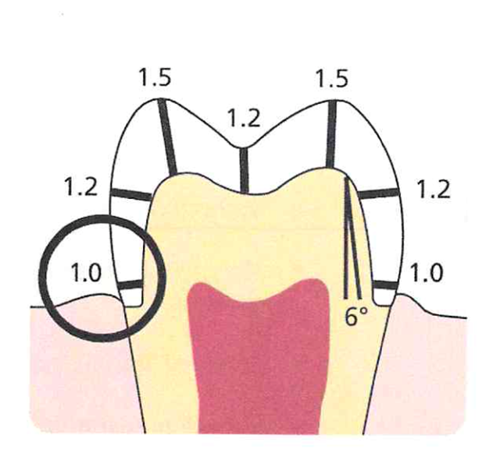
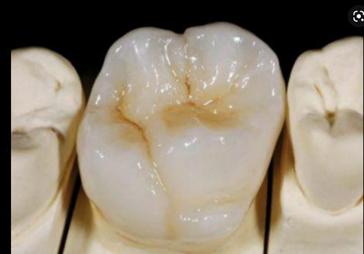
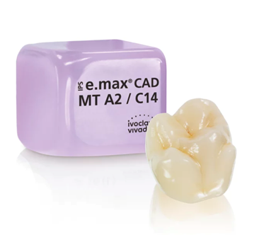
Emax
Can be made by Lab (Press) or milled chairside (CAD)-Widely available now
Emax Press gives best aesthetics
Although can be cemented with traditional cement, if there is height and taper, it is best to bond with resin cements as strength of crown comes from the strength of bond to underlying tooth
Ensure rounded line angles and smooth preparation
Best to have composite core underneath rather than amalgam for strength of bond
Labs can place opaquer to mask any discolouration from underlying tooth
Can achieve high bond strength if follow good bonding practice

Slide 10
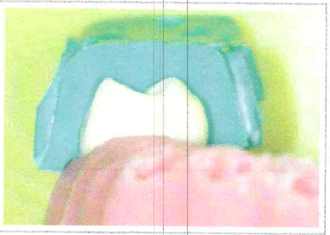
Tips!
Always take Periapical before preparation of tooth
Use Matrix to assess your depth
Know the depth of your burs and create depth grooves to aid effective preparation
Cut with the direction of the bur. This creates less heat and gives more control
3 finger rest technique is always best
Use finishing burs to make sure your prep is smooth. This will help get better impression and flow of cement.
IDS (immediate dentine seal any dentine to reduce sensitivity and improve bond strength)
Use fresh burs with lots of water!
Spend time making a good temporary crown. This will make things much much easier when comes to fit

Slide 11
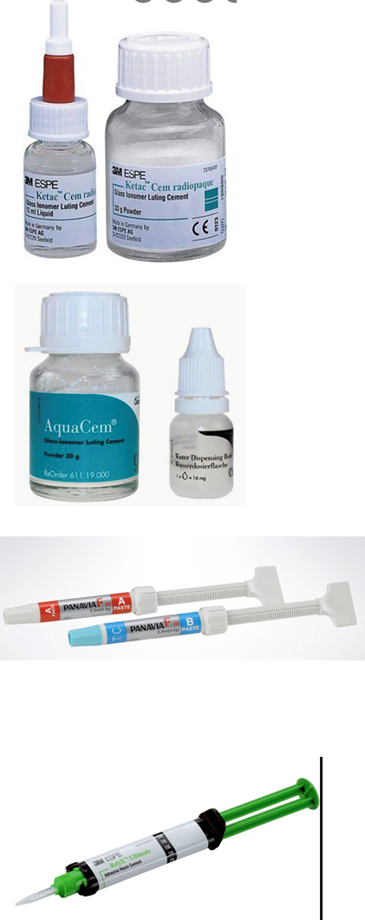
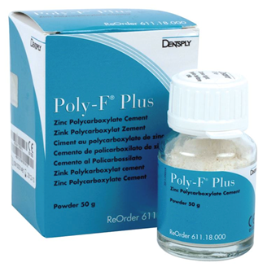
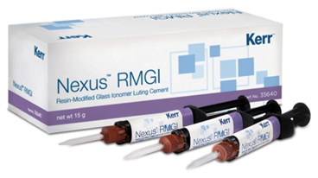
Cements
Zinc Based
Zinc phosphate
GIC
Chemical bond to tooth
Resin
Strongest cements
Resin Modified-GIC
GIC with the addition of Resin
Zinc polycarboxylate
Good long standing history
Chemical bond to tooth
Release fluoride (Poly-F)
Strong
Low PH
Light, Chemical or duel cure
Most technique sensitive
Used for all restorations except for all-ceramic crowns.
Easy to do – if you know what you’re doing!

Slide 12
FURTHER READING
Inside Dentistry, November 2012, Volume 8, Issue 11
An Overview of Permanent Cements
What a general practitioner needs to know to select the appropriate dental cement.
By Mojdeh Dehghan et al
Int Journal of Prosthodontists 2012 Jan-Feb, 25(1):70-8
Clinical long-term evaluation and failure characteristics of 1,335 all ceramic restorations
Beier US et al
Biomimetic Restorative Dentistry Vol 1
Magne, Pascal / Belser, Urs C

