Slide 1
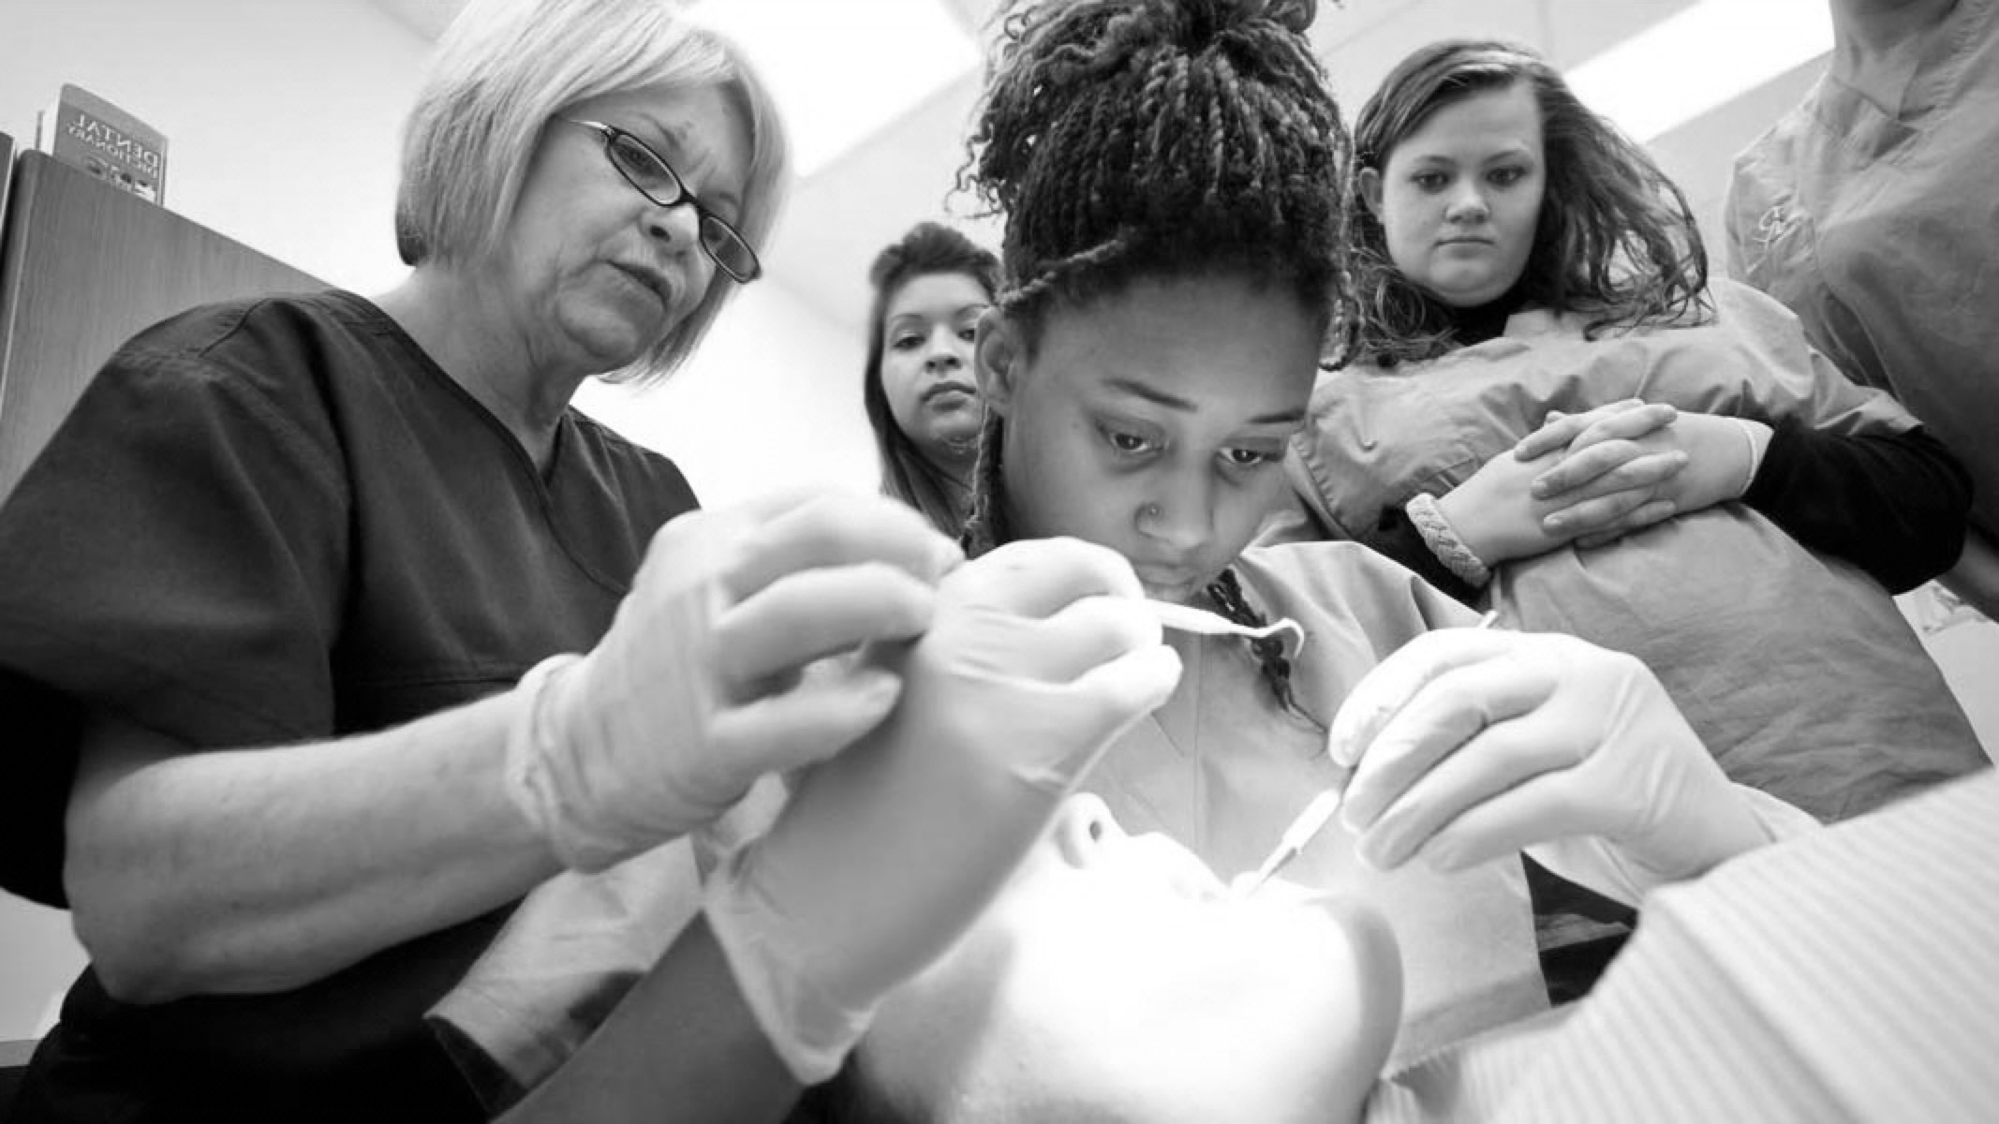

Denture Materials
BUPA/DTC LEARNING TOOL

Slide 2
GDC OUTCOMES
Knowledge of the types of materials used for removable prostheses
B
AIMS AND OBJECTIVES
To understand the advantages and disadvantages of different denture base materials and their indications

Slide 3

INTRODUCTION
Almost 20% of adults in the UK are denture wearers, 13% requiring partial dentures
Acrylic: Polymethylmethacrylate (PMMA) resin
CoCr - Cobalt - Chromium Alloy
Flexible – None-metal clasp dentures – thermoplastic materials

Slide 4

Acrylic
Cobalt Chrome
Thermoplastic
1
2
3

Slide 5
PROS AND CONS
ACRYLIC
ADVANTAGES
DISADVANTAGES
Most popular material (5 Acrylic RPDs made for every 1 CoCr)
Indicated for both intermediate, transitional & long-term partial & complete prostheses
None-rigid material that requires thickness for strength - dentures tend to be bulkier and larger
More coverage of the mucosa - so reduced sensory perception - taste & heat
Cheaper to manufacture
Can easily be added to
Increased surface for plaque retention, mucosal and gingival coverage, and occlusal forces transmitting to remaining teeth → negative impact on periodontal health
Patient’s own plaque control is the biggest factor in this
Lightweight (compared to CoCr)
Can easily be relined

Slide 6
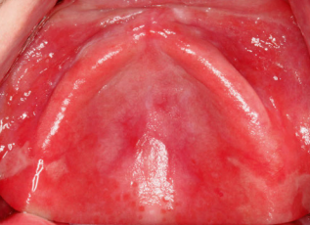
ACRYLIC: DISADVANTAGES
Supported by the mucosa → resorption results in inadequate support → increasing the potential for damage to the soft tissues
If incorrectly designed this can result in loss of attachment - “gum stripping” especially in lower arch
Leakage of residual monomer & additives has potential to cause allergy, irritation, cytotoxicity
Olms, C., Yahiaoui-Doktor, M., & Remmerbach, T. W. (2019). Contact allergies to dental materials. Swiss dental journal, 129(7-8), 571–579.

Slide 7
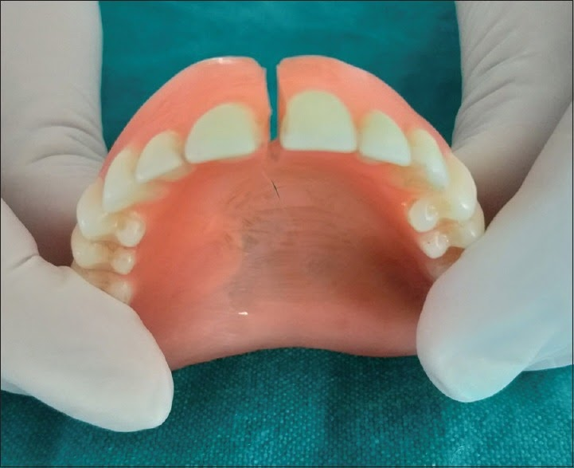
ACRYLIC: FRACTURE
Cost to NHS of repairing fractured dentures in England and Wales during 2004/05 was over £3.6 million (Dental Practice Board Statistics, England and Wales)
Denture may fracture because of function/ because they are accidentally dropped
Increased risk : deep labial fraenum notch; opposing natural teeth; occlusal problems, poor fit, presence of tori, thin areas of acrylic, varying compressibility of underlying tissue (eg flabby ridge), and processing error
Can use enhanced PMMA, with addition of rubber to enhance the physical properties – a.k.a. “High-Impact Acrylic – very difficult to crack
Choudhary S. (2019). Complete denture fracture - A proposed classification system and its incidence in National Capital Region population: A survey. Journal of Indian Prosthodontic Society,

Slide 8
TIPS ON ACRYLIC DENTURE DESIGN
Saddle - should be extended, and where the acrylic contacts tooth this should be on or above the survey line to gain some tooth-support
Retention - Through use of wrought clasps and these must be reciprocated
When processing for fit - should ask the technician to block out the undercuts
Review the design
Gingival coverage should be kept to a minimum - only where necessary

Slide 9
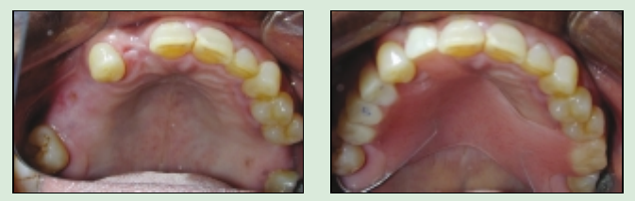
”EVERY” DENTURE
For upper acrylic partial denture with bounded saddles
6 principles that result in a good design:
Point contact between abutment and artificial teeth
Wide embrasure space between abutment and artificial teeth - reduces plaque accumulation
Free occlusion - no interferences that could produce damaging lateral forces
Uncovered gingivae - at least 3mm distance
Distal stabilisers that contact the distal surface of the last standing teeth - prevent distal drift
Maximum retention following principles of complete denture design ie. Extension of base connector
Walmsley, A. D. (2003). Acrylic Partial Dentures. Dental Update

Slide 10
Acrylic
Cobalt Chrome
Thermoplastic
1
2
3

Slide 11
PROS AND CONS
CoCr
ADVANTAGES
DISADVANTAGES
Used since 1920s to replace gold alloys
Stronger, so framework is thinner - feels less bulky compared to acrylic
Cost
Visibility of the metal components – aesthetic issues
Less mucosal coverage, better for sensory perception
Indicated for long-term partial dentures
Difficult to add to/ Reline
Abutment teeth can undergo attachment loss if incorrect design
Improved retention through clasps – less reliance on muscular control to retain
Most require tooth preparation

Slide 12
Acrylic
Cobalt Chrome
Thermoplastic
1
2
3

Slide 13
THERMOPLASTIC: ADVANTAGES
Nylon-derived denture base material were introduced in the 1950s
Many types of thermoplastic materials like nylon (polyamides), polyesters (polyethylene terephthalate), polycarbonates, acrylics (polymethyl methacrylate), polypropylenes and acetal resin (polyoxymethylene)
Denture base can be made thinner due to flexibility & strength, and can be made into tooth-coloured clasps
Flexibility of nylon allows extension of denture bases into bony undercuts & interproximal spaces, without blocking these areas out on the master cast, both gaining retention & simplifying laboratory procedures
Laboratory processes are quicker & simpler than the construction of a CoCr

Slide 14
EVIDENCE
Few studies into the use of the material
One trial showed 100% of patients preferred this material to their previous dentures regarding the following aspects: mucosal irritation, halitosis, fractures and comfort (Singh, 2011)
Another study showed better function, speech and comfort of maxillary complete flexi dentures opposing natural teeth, with much fewer midline fractures - an issue with acrylic (Dhiman & Chowdhury , 2009)

Slide 15
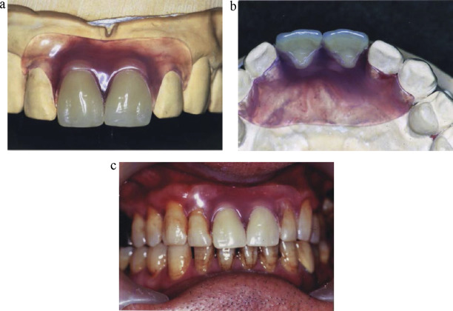
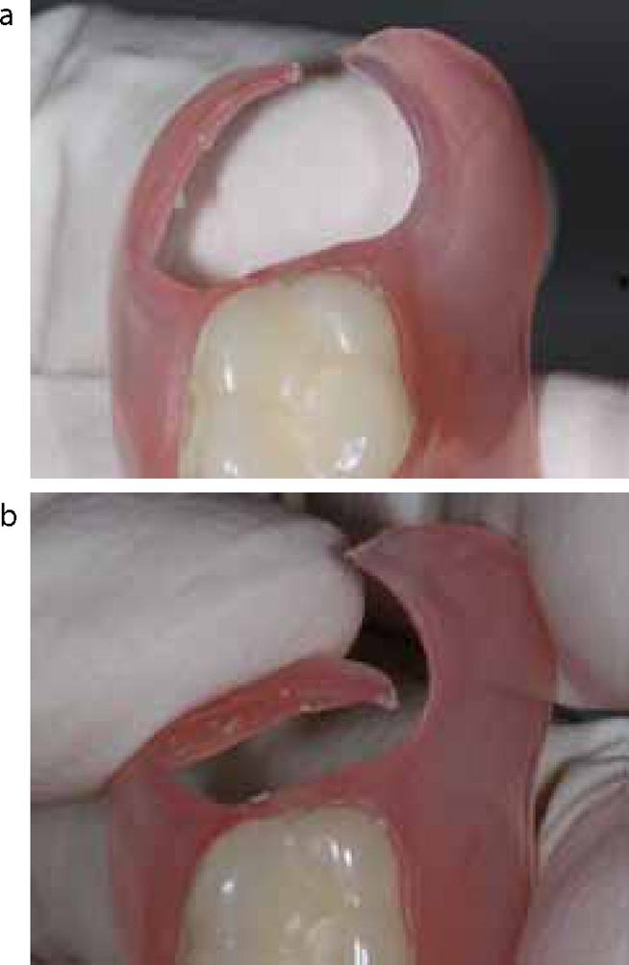
THERMOPLASTIC DENTURES
Valplast - a polyamide resin developed from a type of nylon material
Flexible clasp.
Rickman, L. J., Padipatvuthikul, P., & Satterthwaite, J. D. (2012). Contemporary denture base resins: part 2. Dental Update

Slide 16
THERMOPLASTIC: DISADVANTAGES
Lower colour stability & surface roughens easier in comparison with conventional acrylic
Increasing flexibility of the denture base results in decreasing counter/balancing force in denture → less even distribution of the forces over all the tissues including to teeth and the primary support areas → increasing the risk of resorption
Clasps & reciprocating arms cover a large surface area, including gingival margins and more tooth tissue than metal clasps, affecting plaque control and increased risk of periodontal inflammation
Increased risk of clasp fracture

Slide 17
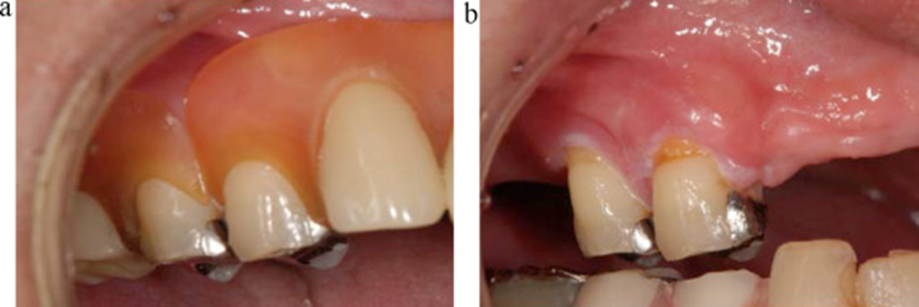
THERMOPLASTIC: DISADVANTAGES
Effect of marginal gingival coverage.
Fueki, K., et al. (2014). Clinical application of removable partial dentures using thermoplastic resin. Part II: Material properties and clinical features of non-metal clasp dentures. Journal of Prosthodontic Research.

Slide 18
TAKEAWAY MESSAGES
Important to emphasise to the patient the importance of denture and oral hygiene
Careful design and planning of all prostheses
Denture design is equally as important for acrylic dentures
Regular recall

Slide 19
REFERENCES AND FURTHER READING
Choudhary, S. (2019). Complete denture fracture – A proposed classification system and its incidence in National Capital Region population: A survey. The Journal of Indian Prosthodontic Society, 19(4), 307. https://doi.org/10.4103/jips.jips_312_18
Dhiman, R., & Chowdhury, S. R. (2009). Midline Fractures in Single Maxillary Complete Acrylic vs Flexible Dentures. Medical Journal Armed Forces India, 65(2), 141–145. https://doi.org/10.1016/s0377-1237(09)80128-7
Fueki, K., Ohkubo, C., Yatabe, M., Arakawa, I., Arita, M., Ino, S., Kanamori, T., Kawai, Y., Kawara, M., Komiyama, O., Suzuki, T., Nagata, K., Hosoki, M., Masumi, S. I., Yamauchi, M., Aita, H., Ono, T., Kondo, H., Tamaki, K., . . . Yatani, H. (2014). Clinical application of removable partial dentures using thermoplastic resin. Part II: Material properties and clinical features of non-metal clasp dentures. Journal of Prosthodontic Research, 58(2), 71–84. https://doi.org/10.1016/j.jpor.2014.03.002
McCord, J. F., Grey, N. J., Winstanley, R. B., & Johnson, A. (2002). A Clinical Overview of Removable Prostheses: 3. Principles of Design for Removable Partial Dentures. Dental Update, 29(10), 474–481. https://doi.org/10.12968/denu.2002.29.10.474
NHS. (2011). 2009 Adult Dental Health Survey. https://digital.nhs.uk/data-and-information/publications/statistical/adult-dental-health-survey/adult-dental-health-survey-2009-summary-report-and-thematic-series
Olms, C., Yahiaoui-Doktor, M., & Remmerbach, T. W. (2019). Contact allergies to dental materials. Swiss dental journal, 129(7-8), 571–579.
Rickman, L. J., Padipatvuthikul, P., & Satterthwaite, J. D. (2012a). Contemporary denture base resins: part 1. Dental Update, 39(1), 25–30. https://doi.org/10.12968/denu.2012.39.1.25
Rickman, L. J., Padipatvuthikul, P., & Satterthwaite, J. D. (2012b). Contemporary denture base resins: part 2. Dental Update, 39(3), 176–187. https://doi.org/10.12968/denu.2012.39.3.176
Singh, J., Dhiman, R., Bedi, R. P. S., & Girish, S. (2011). Flexible denture base material: A viable alternative to conventional acrylic denture base material. Contemporary Clinical Dentistry, 2(4), 313. https://doi.org/10.4103/0976-237x.91795
Walmsley, A. D. (2003). Acrylic Partial Dentures. Dental Update, 30(8), 424–429. https://doi.org/10.12968/denu.2003.30.8.424

