Slide 1
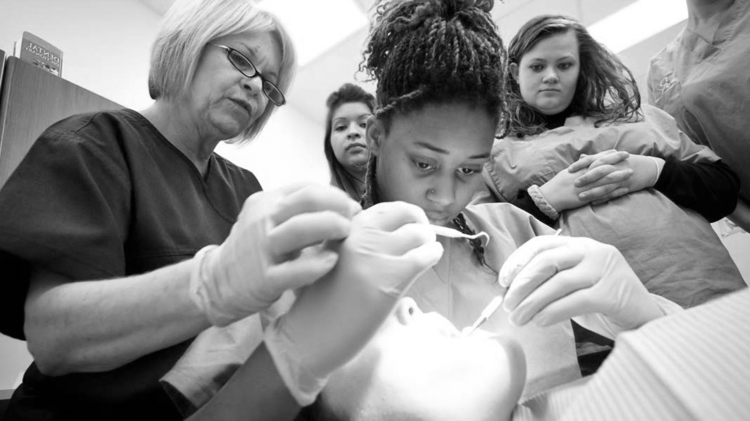
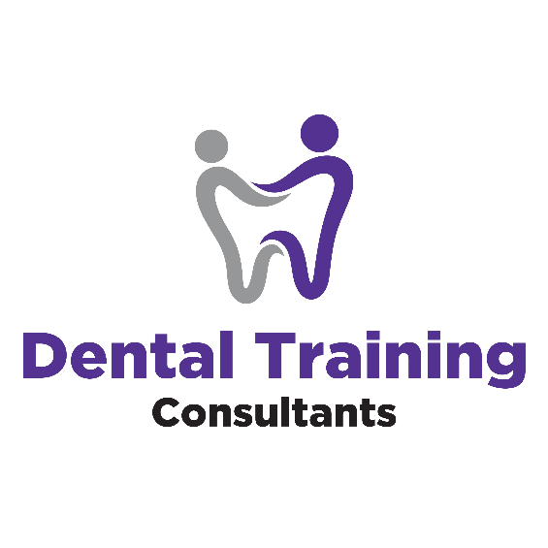
DIRECT VS INDIRECT RESTORATIONS BUPA/DTC LEARNING TOOL

Slide 2

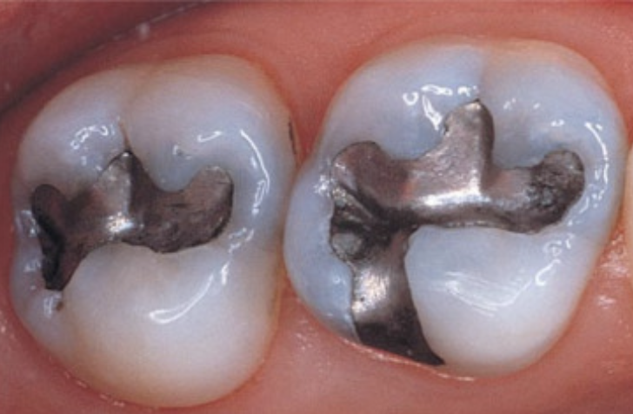
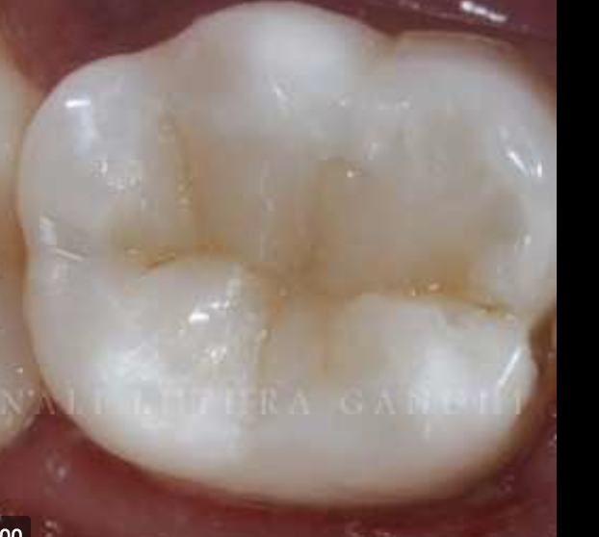
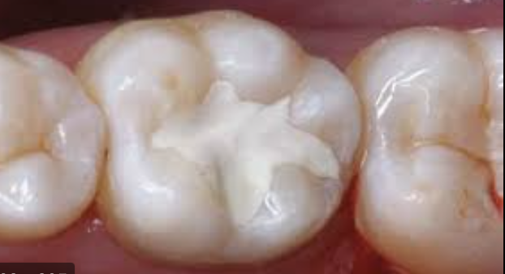
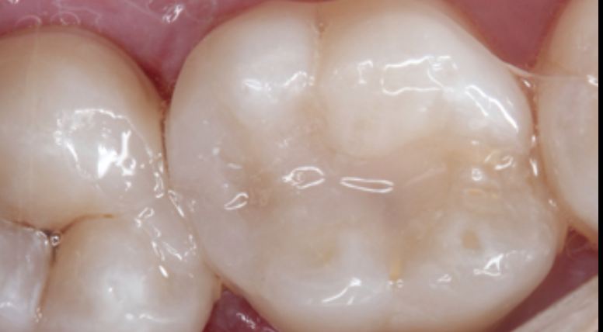
DIRECT RESTORATIONS
TYPES :
Amalgam:
Alloys of mercury and different metals that sets on packing. Advantage is that it’s cheap, easy to place even in moist environments and also strong. Disadvantage is that it is not aesthetically pleasing and also does not bond to tooth. Also contains Mercury which can be toxic in high concentrations.
Composite Fillings:
Made of Resins that are tooth coloured and can be shaped and cured. Aesthetically more pleasing however are more technique sensitive and also more expensive than other restorations
Glass Ionomer:
Restorations are a mixture of silicate glass and polyacrylic acid. This chemically bonds to tooth and usually contains fluoride releasing particles however they are not very strong and are not great on contact areas.
Direct Restorations
With direct dental restoration, all of the work is fabricated and completed within the mouth. The procedure, commonly referred to as filling, involves the placement of a malleable substance into a prepared and cleaned cavity. The material is then hardened to restore the structure (and sometimes appearance) of the damaged tooth.

Slide 3
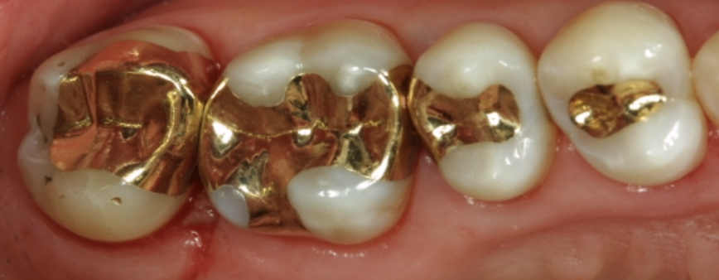
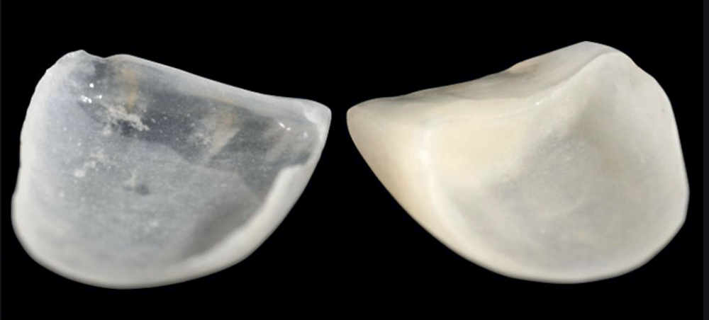
INDIRECT RESTORATIONS
With indirect dental restoration, the fabrication occurs outside of the mouth.
Examples include veneers, crowns, bridges, implants, inlays, and onlays. Because the procedures require more work (such as a dental impression, tooth preparation, fabrication, and a temporary veneer, bridge, or crown), they tend to be costly. On the upside, they can increase the aesthetic appearance of your teeth or provide a more stable, longer-lasting solution when the damage is severe or extensive.

Slide 4
PROTOCOL
After diagnosing caries both clinically and radiographically you must determine whether a direct or indirect restoration is required.
You must give the options including advantages and disadvantages including your recommendations and why as well as cost

Slide 5
ADVANTAGES OF DIRECT RESTORATIONS
Usually performed in one visit
Cheaper than Indirect
Less chair time
Induce less wear on opposing teeth
Minimal invasiveness
Potential for Repair
Increased strength of remaining tooth structure

Slide 6
DISADVANTAGES OF DIRECT RESTORATIONS
Increased stress on tooth
Increased chance of leakage
More susceptible to caries than the other restorations
Less aesthetic than indirect restorations
Technique sensitive

Slide 7
ADVANTAGES OF INDIRECT RESTORATIONS
High Mechanical Strength
Better Aesthetics
Improved contact to adjacent teeth
Less Polymerization stress on tooth
Less chance of sensitivity
Less chance of cusp fracture
High fracture toughness
Less chance of leakage
Increased wear resistance
Good biocompatibility

Slide 8
DISADVANTAGES OF INDIRECT RESTORATIONS
Increase cost
Increased time
Technique sensitive
Difficult to polish
Low potential for repair
Ceramics brittle

Slide 9
RERFERNCES AND FURTHER READING
Clinical performance of direct versus indirect composite restorations in posterior teeth: A systematic review
J Conserv Dent. 2018 Jan-Feb; 21(1): 2–9.
Rubeena Abdul Azeem
Assessment of Mechanical Properties of Dental Restorative Materials
August 2021
Manual of Laboratory Testing Methods for Dental Restorative Materials

