Slide 1
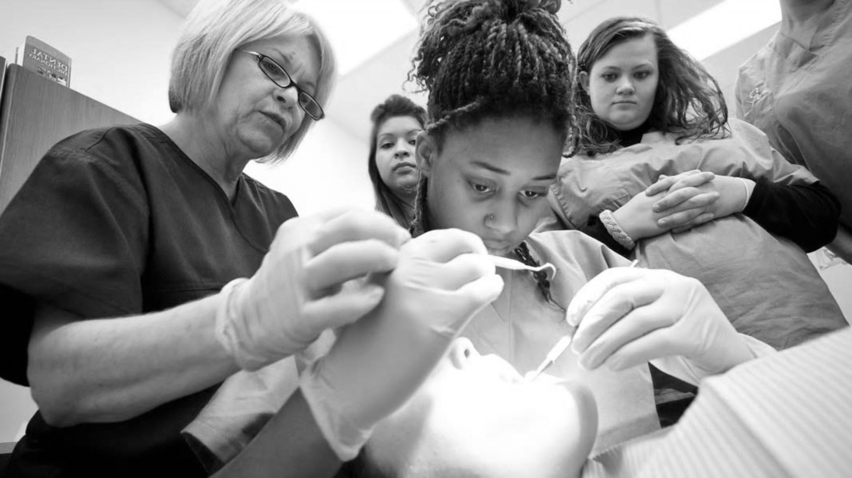

Final Fit of Removable Dentures BUPA/DTC LEARNING TOOL

Slide 2


GDC OUTCOMES
A. Communication with the patient on denture wearing and hygiene instructions
C. Knowledge of fitting removable partial and complete denture
To ensure confidence in fitting a removable prosthesis
To ensure adequate instruction is given to the denture patient
How to identify and adjust completed dentures for comfortable and satisfactory fit
To understand how to adjust occlusion
To give comprehensive care instructions to a patient
To review a denture
To diagnose and treat Denture Related Stomatitis

Slide 3

Fitting Partial Dentures
The denture is examined for quality of finish
There should be no enamel pearls/ sharp edges
Denture is inserted along the path of insertion
If it does not seat - undercuts may not have been blocked out - and can be adjusted
If the mucosa around the flange is blanched, this needs to be adjusted
Once seated and comfortable, the denture is checked for stability and retention
Occlusion is checked with paper, visually, and by asking the patient
This should be in both ICP/RCP and protrusive & lateral excursions

Slide 4

Fitting Partial Dentures
Heavy contacts are shown by target markings - light centre with a ring of dark ink
BULL Rule -> Buccal Upper, Lingual Lower
If a premature contact occurs between buccal cusps on the working side during a lateral excursion, the buccal maxillary cusp is adjusted
Mic versa if the lingual cusps contact
Show the patient the denture in the mirror
The patient should be able to insert and remove the denture independently, without deforming any clasps
Review appointment booked in one week

Slide 5
Fitting Complete Dentures
Inspect quality of finish, sharp edges etc
Test retention of upper denture by applying pressure to the incisal area to break border seal
Test stability by applying pressure to posterior occlusal surfaces on one side on upper and lower denture
Check fraenal tissues are unrestricted and deepen notch if required
Pressure indicating paste can be used on fit surface - a thin layer is applied and then the denture is placed in the mouth, force is applied to occlusal surfaces
Any areas where acrylic shows through are carefully adjusted
The process is repeated until a uniform layer of paste is seen all over

Slide 6
FITTING COMPLETE DENTURES
Vertical dimension is maintained by palatal cusps of maxillary teeth and buccal cusps of lower teeth
If an interference occurs during ICP and lateral excursion, the cusp is adjusted (Buccal upper/ Lingual lower rule)
If interference occurs during ICP only, central fossa of opposing tooth is adjusted
Encourage patient to look at the denture, and practice speaking
Instruct patient in how to place their tongue so it can weigh down lower denture
The patient should be able to insert and remove the denture independently
Review appointment booked in one week

Slide 7
Denture Instructions
Denture should be rinsed and cleaned after every meal
Soap or none-abrasive toothpaste can be used, with cold/ warm water and single tufted/ interdental/ large toothbrushes
Very hot water can result in damage (crazing) to the acrylic
Dentures to be kept out at night, preferably in an immersion cleanser (NB hypochlorite is contradicted for cobalt chrome dentures) and rinsed before reinserting in the morning
Given verbally and in writing
Reinforce the fact that successful wearing of dentures requires development of muscular control and this takes time
Softer, none sticky food to begin with
For remaining teeth - oral hygiene should be maintained to high standard
If there is a significant problem/ pain in the first week of wearing the denture, it should be removed and worn for a few hours before the denture review appointment

Slide 8
OPEN APEX
History is taken from patient
Dentures are examined in the mouth
Hygiene of the denture is examined
Soft tissues and denture bearing areas are inspected for signs of inflammation/ trauma
Pressure indicating paste may be used
Occlusal interferences can overload the denture in certain areas producing pain - so check again
If required book a second review appointment
The patient needs regular recall
Continued resorption may require reline

Slide 9
PERIODONTAL INJURIES
Seen in up to 75% of denture wearers
Chronic inflammation of the tissues supporting a denture - commonly maxilla, usually secondary to colonisation by Candida (<10% cases caused by bacteria)
Asymptomatic usually, can cause bleeding, burning mouth, xerostomia, halitosis
Local risk factors: denture trauma, poor denture hygiene, night time wearing
Systemic factors: smoking, diabetes, nutritional & immune deficiencies, xerostomia, steroid & antibiotic treatment, head & neck radiotherapy, high sugar diet
Presents in 3 distinct types; localised, diffuse, papillary
Puryer, J. (2016). Denture stomatitis – a clinical update. Dental Update

Slide 10
Denture Related Stomatitis: Treatment
Denture hygiene advice - leaving denture out at night to dry, improved brushing, soaking in hypochlorite solutions
Smoothing rough surfaces
Remaking unsuitable dentures
Modifying lifestyle factors, and systemic actors in liaison with GP
Dietary advice
Antifungals, in conjunction with other options
Miconazole 24 mg/ml gel – applied to fit surface of the denture QDS; use for 2 days after lesions have healed
Fluconazole 50 mg capsules – OD, 7-14 days
Nystatin 100,000 units/ml oral suspension – oral rinse QDS after food for five minutes, and then swallowed. 7 days +/- 2 days after lesions have healed. Avoid rinsing/ eating/ drinking immediately after use
Miconazole and Fluconazole: interact with warfarin

Slide 11
RERFERNCES AND FURTHER READING
Davenport, J. C., Basker, R.M., Heath, J.R., Ralph,J.P., & Glantz, P., (2007). A clinical guide to removable partial dentures. British Dental Association.
McCord, J. F., & Grant, A. A. (2000). Trial dentures, insertion of processed dentures and review of complete dentures. British Dental Journal, 189(1), 4–8. https://doi.org/10.1038/sj.bdj.4800585
Puryer, J. (2016). Denture stomatitis – a clinical update. Dental Update, 43(6), 529–535. https://doi.org/10.12968/denu.2016.43.6.529
The Faculty of General Dental Practitioners UK, (2020). Antimicrobial prescribing for general Dental practitioners, 3rd edition.

