Slide 1
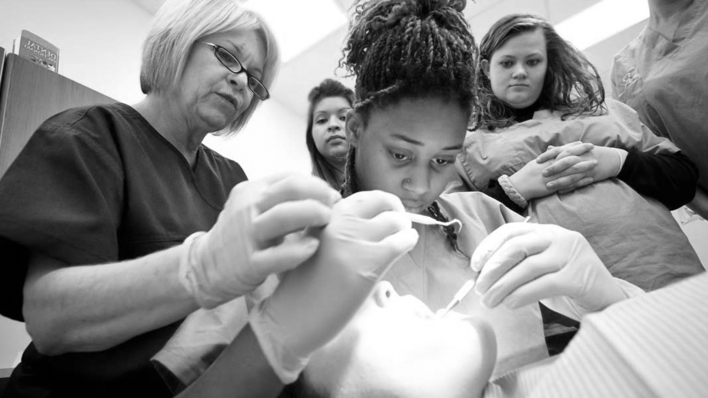

Glass Ionomer Cements (GIC)
BUPA/DTC LEARNING TOOL

Slide 2
GDC OUTCOMES
To be able to communicate effectively with the patients making sure you can discus the benefits v disadvantages of using GIC in dentistry whilst obtaining a valid consent
Improve clinical knowledge about dental materials. Understanding theory and practical elements behind the indications of using GIC and how it should be used appropriately in the patient’s best interests. Understanding the differences in the dental materials and to be aware of each of their limitations.
A
C

Slide 3

AIMS AND OBJECTIVES
To understand the basic composition of GIC
To identify the properties of GIC
To understand the advantages and disadvantages of the material and be aware of its limitations
To have adequate knowledge on the literature behind GIC
To be aware of the different types of GIC including modified RMGIC

Slide 4
INTRODUCTION
Glass Iononmer Cements (GIC) – versatile biocompatible material that can be used in a range of applications in general dentistry
Introduced in UK by Wilson and Kent 1972
Types of GIC:
Conventional GIC – Fuji IX, ChemFill
Resin Modified GIC – e.g. Fuji II, Viva glass

Slide 5

Theory
Considerations
Practical Implementation
1
2
3

Slide 6
Composition of Conventional GIC
Polyalkenoic acid
Polyitatinic acid / Polymaleic acid
Glass powder – Calcium Fluoroaluminosilicate glass
Tartaric acid
Water
Heavy Metal Salts – typically strontium for radiopacity

Slide 7
CHEMICAL REACTIONS
GIC undergoes acid/base rxn ⟶ autocure: mixing powder (glass powder) + liquid (acid)
Chemically, the set material is composed of a sodium aluminium fluorosilicate reacting with
polyacrylic or maleic acid in an exothermic reaction
GIC adheres to enamel and dentine. This is via the ionic displacement of calcium and phosphate
with polyacrylate ions and/or the possible absorption of polyalkenoic acid onto collagen which
then set and harden in a matrix.
Ideally before bonding to enamel or dentine the smear layer needs to be removed by conditioning
using 10% polyacrylic acid for 10 seconds to freshen the surface for the GIC to adhere / bond. For
better prognosis the tissue / structure of enamel / dentine must be in tact and not damaged.

Slide 8
Theory
Considerations
Practical Implementation
1
2
3

Slide 9
PROPERTIES
Bulk placement possible
No need for bonding agents as adherent to both dentine and enamel
Biocompatible – low toxicity
Good insulating property
Unique thermal expansivity
Therapeutic – leaches Fluoride
Aesthetics: Appears as dense and opaque, due to phase separation of glass and mismatch of refractive
index
Phase separation can be overcome by changing the Al, Ca & F content but this affects the strength
adversely

Slide 10
PROS AND CONS
ADVANTAGES
DISADVANTAGES
Does not need moisture control
Ease to use
Adheres to tooth enamel and dentine– minimally invasive
Low shear strength and fracture resistance – brittle
Less aesthetic than composite restorations – yellowish in colour
Short Working Time
Versatile material
Better aestehtics than amalgam
Does not need bonding agents
Susceptible to early water contamination
Not as wear resistant as amalgam
Long setting time – can take 24 hours to mature
Therapeutic Action – release of Fluoride
Abrasive – rough surface

Slide 11
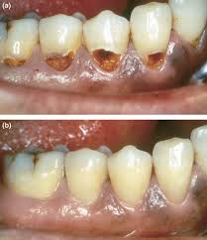
CHEMICAL REACTIONS
WHY USE GIC?
It is adhesive to enamel and dentine, so is very easy to use and , as it doesn’t require any bonding agent. Therefore, minimum cavity preparation required, so easy to use on children and other specific cases and does not require moisture control.
It is useful to use as a filling material for patients that are susceptible to caries, as it leaches fluoride for a relatively long period of time, benefiting the tooth itself and those in close proximity, therefore clinically “anti-cariogenic”.
GICs can also be used for permanent cementation of crowns, bridges, veneers and other dental appliances, mostly as they bond directly to teeth with minimum preparation.
They are also used as a material for fissure sealants, as the fluid consistency of GIC is easily adaptable to suit the treatment that is required and its anti-cariogenic properties.
They are very useful as liners and bases, underneath various materials, such as amalgam and composite for a range of functions.
Should not be used in stress bearing areas with heavy occlusal load such as posterior occlusal cavities due to brittle nature. Better used as a bulk fill in thicker segments. Ideally suited to Class III and class V cavities.

Slide 12
Theory
Considerations
Practical Implementation
1
2
3

Slide 13
HOW TO USE?
To achieve long lasting restorations and retentive fixed prostheses, the following manipulative considerations for GIC must be satisfied:
Surface of the prepared tooth must be clean and dry
For Fillings – < 3:1 powder: acid (stiffer) and for luting cements 1.5:1 powder: acid (less viscous) and mixed on cold glass slab using a spatula
If a cavity is deep, a calcium hydroxide liner may have to be used prior to the GIC.
Fill cavity with ball-shaped GIC material, and excess cement is removed and shaped before it sets, using instruments such a flat plastic and packed using a plugger
Allow material to set in dry conditions to maintain maximum strength (sets through acid-base reaction) and restoration surface must be protected to prevent cracking/ dissolution.

Slide 14
RESIN MODIFIED GIC
RMGICs are direct restorative materials used for lining, luting and restoration. They consist of the same composition as conventional GIC but with added 5% resin – 2-HEMA simila to composites
Setting involves a polymerization reaction initially, but an acid-base reaction then strengthens the resultant matrix; this second stage of setting usually being initiated by a light curing process. Autocure continues up to 1 month after placement – via chemical polymerisation
Properties of RMGIC:
Similar to conventional GIC
Early stage desiccation reduced
2-Hema cytotoxic to pulp tissues and osteoblasts so for deep fills need to use Dycal / pulp protection liners
Resin is hydrophilic and so over time water may cause degradation of fill

Slide 15
RESIN MODIFIED GIC
Advantages | Disadvantages
Still able to leach fluoride to encourage remineralisation | Exogenous staining over time as water is absorbed due to presence of HEMA
Can be used on the primary dentition as longevity not a concern as primary teeth will exfoliate | It becomes globular in saliva making ease of manipulation quite difficult.
Command set properties | Less wear resistant than conventional GIC’s.
Extended working time with rapid setting compared to conventional GICs | Users should be aware of the sensitising potential of their resin constituents.
Improved aesthetics compared to conventional GICs | Need to mix to the correct consistency, lest the material be too sticky to handle easily during placement.
Improved tensile strength compared to conventional GICs | Still not as mechanically strong as composites

Slide 16
RERFERNCES AND FURTHER READING
Pickard’s Manual of Operative dentistry, A Banerjee
Oxford Handbook of Clinical Dentistry
Mechanical and optical properties of conventional restorative glass-ionomer cements - a systematic review, Menezes-Silva et al 2019
Dental Glass Ionomer Cements as Permanent Filling Materials? —Properties, Limitations Future Trends, Lohbauer 2009
Chemistry of glass-ionomer cements: A review. Biomaterials, W.J Nicholson 1998
The forgotten merits of GIC restorations: a systematic review, Mustafa et al 2020

