Slide 1
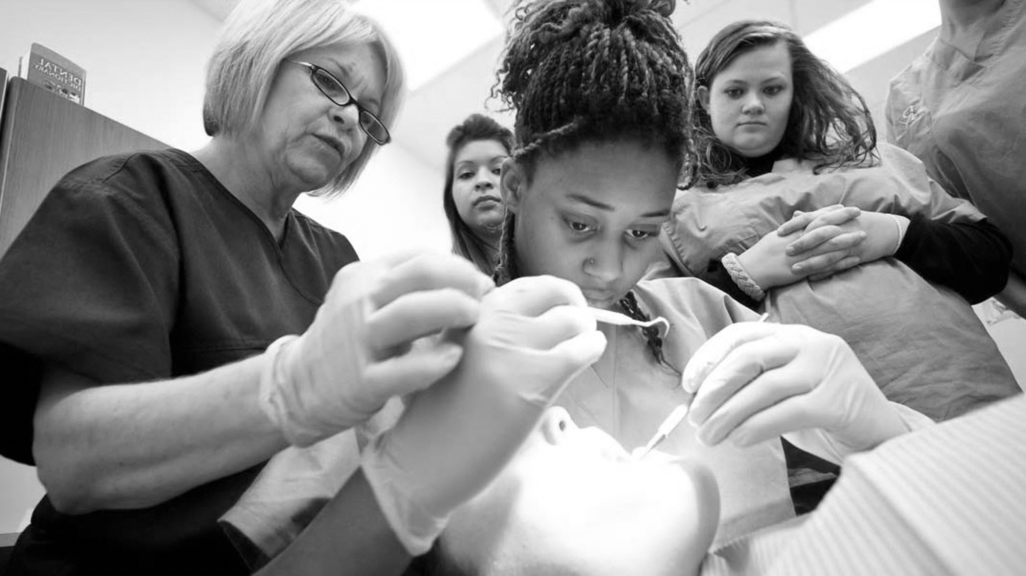

Impressions
BUPA/DTC LEARNING TOOL
Notes:
EXCITED

Slide 2
GDC OUTCOMES
Maintenance and development of knowledge and skills in taking impressions for removable prostheses
C

Slide 3

AIMS AND OBJECTIVES
To review the different types of impression materials
To understand how to carry out primary & secondary impressions
Describe which impression materials are indicated and why
Knowledge of the anatomical landmarks in edentulous patients
Outline the process of taking impressions including modification of trays
Describe the Selective Pressure technique & indications for its use
Recommend techniques for the management of gagging patients

Slide 4
IMPRESSION MATERIALS
Impression materials can be none-elastic/ elastic
None-Elastic Materials
Greenstick
Used to correct extension of trays
Softened with heat and applied to the desired border
Temper in warm water and place in patient’s mouth
Once cooled it is hard and brittle
Zinc Oxide Eugenol
Good surface detail, can be used for edentulous patients, secondary imps, and for jaw reg
A stable material that can be added to
Vaseline should be applied to the lips and no adhesive is required
Not suitable for severe undercuts
Quite messy, has a poor taste and allergy to the material should be checked

Slide 5
IMPRESSION MATERIALS
Elastic
Alginate
A hydrocolloid
Gives good surface detail
Can only be poured once
Available to set over different speeds
Warmer water will decrease setting time
Suitable material for primary impressions
Secondary impressions - alginate may also be used if there are no severe undercuts that would stress the material on removal from the mouth - if so use an elastomeric impression material
Should be stored in 100% humidity (sealed bag with damp gauze), should be cast as soon as possible
Dimensionally stable over 5 days
Synthetic Elastomer
Polysulphide
Not popular
Used for complete dentures where a longer working time was needed
Have an unpleasant taste and smell, long setting time (10 mins +), messy to use, distortion on setting

Slide 6
IMPRESSION MATERIALS
Polyether
Accurate, very dimensionally stable
Not to be used in special trays, or severe undercuts/ bridges - very rigid when set
Used for secondary imps for partial dentures, fixed pros, implant imps
Stored dry
Silicone is hydrophobic so teeth should be dried prior to use to prevent air blows
Addition Silicone
Most commonly used material, also called PVS (polyvinyl siloxane)
Setting reaction results in no by-product - excellent dimensional stability
Stored dry
Light-body used with medium body/ putty for wash impression for fixed pros, or as a jaw reg material in removable pros
Medium-body is used as an imp material and multiple casts are possible from a single imp
Silicone putty is used to modify stock trays, and in fixed pros - a putty/wash technique
The platinum catalyst can react with sulphur in latex gloves so use none-latex when mixing the base and catalyst
Condensation Silicone
The first silicone impression material used in dentistry
Less dimensionally stable than PVS - shrinkage once set
Better elastic properties so can be used in undercuts

Slide 7
https://mydentaltechnologynotes.wordpress.com/2018/06/19/complete-denture-anatomical-landmarks/

Slide 8
PRIMARY IMPRESSIONS
Purpose of primary impressions are to produce a study cast to plan denture design and for the construction of special trays
Stock trays are available in various sizes, for both partially dentate and edentulous patients
If teeth present - there should be a space of about 4mm between the flange of the tray and the buccal surfaces of the tray
Where the tray is poorly adapted to oral cavity, silicone putty/ impression compound can be used to fill the dead space (eg palate/ free-end saddle) and moulded intra-orally
Border moulding is carried out by moving the oral tissues, the patient can be asked to purse their lips, and give a big smile
The tray can be extended in the labial flange as well if it is short
This should be cut away where it has made any contact with teeth prior to taking the impression in alginate to allow sufficient thickness

Slide 9
PRIMARY IMPRESSIONS
Once the tray is satisfactory, adhesive is applied and dried and alginate is applied
When taking the lower impression the patient is asked to lift the tongue to the upper lip and then to each corner of the mouth
Border moulding is carried out
Once set and removed - check the impression - in particular the sulci, edentulous areas and teeth (if present)
The impression must be disinfected and stored safely
Alginate impressions should be kept moist and in the fridge to prevent distortion

Slide 10
SECONDARY IMPRESSIONS
Special trays made in acrylic, that are spaced depending on material to be used - usually 3mm for alginate, 2-3mm for elastomers
Close-fitting trays are for use with ZnOE/ medium-body silicone where there are minimal undercuts
For edentulous patients, the upper close fitting none-perforated tray should be retentive in the mouth
Where there are larger undercuts, a spaced tray is more suitable
When using alginate - a spaced, perforated tray is requested
The borders will be trimmed 2mm short of the depth of the sulk, to provide support for the impression material and to allow movement of the tissues during border moulding
Check the tray extension- over-extension can be trimmed and material can be added (such as greenstick/ impression compound)

Slide 11
SECONDARY IMPRESSIONS
The tray should cover the retromolar pads and maxillary tuberosities
Prior to taking the impression, teeth (if present) should be dried, and large interdental spaced may be occluded with soft wax to prevent the impression from locking into place
If using alginate, this can be wiped over the teeth and placed into deep sulci immediately before inserting the tray - this prevents airblows
Do not overload the tray
Once seated, border mould and hold it in position
The patient is asked to raise the tongue to the top lip and move it to the corners of the mouth
Once set - it is removed and inspected for accuracy and airblows, borders should be rounded

Slide 12
SELECTIVE PRESSURE TECHNIQUE
For patients with a “flabby ridge” a conventional impression will displace the tissues
Instead a windowed tray is used
Imran, H. (2018). Five steps to flabby ridge success. British Dental Journal.
The special tray is cut away over the flabby ridge and the impression material (such as ZnOE, alginate, light-body silicone) is painted over the ridge once the loaded tray is seated
Gives an accurate impression of undisplaced tissues
Bansal, R., Garg, R., Kaushala, S., Kumar, M., & Saini, R. (2014). Prosthodontic rehabilitation of patient with flabby ridges with different impression techniques. Indian Journal of Dentistry

Slide 13
GAGGING PATIENT
Although the gag reflex is a normal response, in some patients it can be hypersensitive
Somatogenic group—those in whom physical stimulation produces the gagging reflex
Psychogenic group—those in whom the stimulation appears to be psychological in origin
Tips for taking impressions:
Discussion before hand with the patient can help to ease anxiety
Desensitisation techniques prior to the appointment - the patient takes home imp trays/ wooden spatula and practices - gradually increasing the duration & frequency of exposure
Breathing techniques - slow, deep breathing, inspiration through the nose and prolonged expiration through the mouth
Patient is advised to take deeper and longer breaths if gag reflex is triggered during the imp

Slide 14
Acupressure - works very well - pressure is applied to the “Chengjiang cave” midway between the chin point and the lip - ideally with a thumb (dentist/ nurse/ patient) 5 minutes before the impression is taken util soreness/ tightness is felt
Farrier, S., Pretty, I. A., Lynch, C. D., & Addy, L. D. (2011). Gagging during impression making: techniques for reduction. Dental Update

Slide 15
GAGGING PATIENT
Don’t overload the tray! The use of silicone putty to fill the dead space will reduce the amount of alginate/ flowable imp material used
Seat the patient upright with the head tilted forward, possibly a kidney dish infront of them/ infront of spittoon
Distraction techniques during the procedure: Encourage relaxing visualisation, words of encouragement, asking the patient to raise a leg or arm
Rinsing the mouth with ice-cold water, or salty water prior to taking the impression has been anecdotally effective
The use of topical anaesthetic has also been described, but this is ineffective in severe gag reflexes

Slide 16
RERFERNCES AND FURTHER READING
Bansal, R., Garg, R., Kaushala, S., Kumar, M., & Saini, R. (2014). Prosthodontic rehabilitation of patient with flabby ridges with different impression techniques. Indian Journal of Dentistry, 5(2), 110. https://doi.org/10.4103/0975-962x.135296
Davenport, J. C., Basker, R.M., Heath, J.R., Ralph,J.P., & Glantz, P., (2007). A clinical guide to removable partial dentures. British Dental Association.
Farrier, S., Pretty, I. A., Lynch, C. D., & Addy, L. D. (2011). Gagging during impression making: techniques for reduction. Dental Update, 38(3), 171–176. https://doi.org/10.12968/denu.2011.38.3.171
Imran, H. (2018). Five steps to flabby ridge success. British Dental Journal, 225(7), 597–599. https://doi.org/10.1038/sj.bdj.2018.812
McCord, J., Grant, A. Impression making. Br Dent J 188, 484–492 (2000). https://doi.org/10.1038/sj.bdj.4800516
Turner, J., Moazzez, R., & Banerjee, A. (2012). First impressions count. Dental Update, 39(7), 455-471. doi: 10.12968/denu.2012.39.7.455

