Slide 1
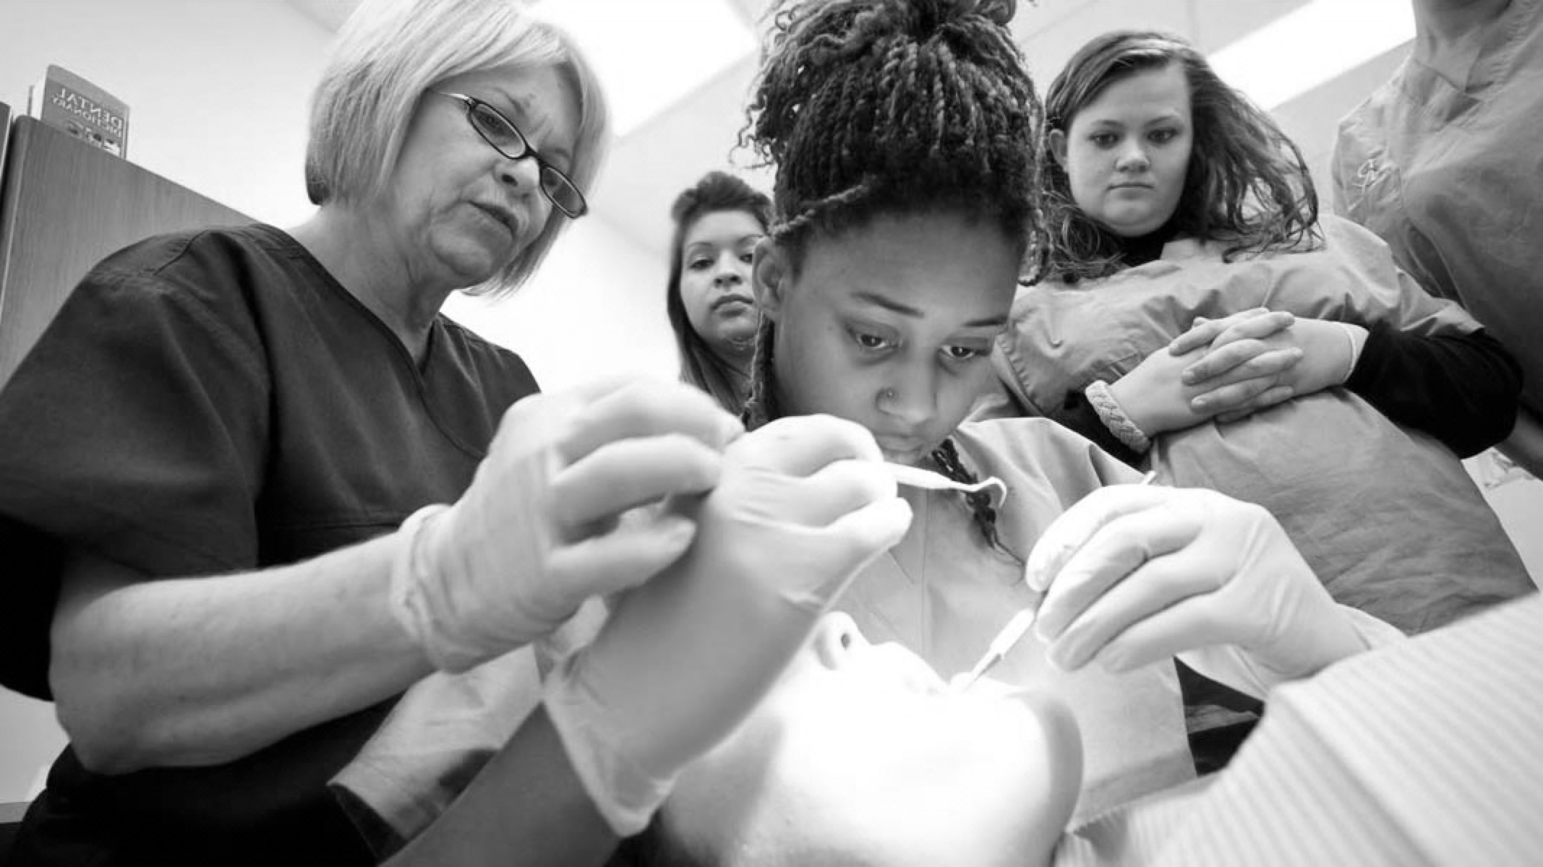

Periodontal Disease Classification and Diagnosis BUPA/DTC LEARNING TOOL

Slide 2
GDC OUTCOMES
To be able to communicate effectively with patients on the diagnosis and treatment options of periodontal disease.
To work effectively with hygienist and other dental team members (e.g. specialists) when referral is offered as an option.
Understanding that classification systems can change and importance of applying this into practice.
A
B
C

Slide 3

AIMS AND OBJECTIVES
To understand the classification of periodontal disease
To identify risk factors in the diagnosis of periodontal disease
To improve confidence on when to refer patients with periodontal disease
To ensure clinical records demonstrate the conversations held with the patient regarding periodontal disease diagnosis, prognosis and treatment options

Slide 4
INTRODUCTION
Periodontal diseases are considered by WHO as one of two global burdens of oral disease, the other being dental caries
Severe periodontitis is recognised as being the 6th most prevalent disease of mankind
Use of the current periodontal classification is key essential
Various risk factors contribute to periodontitis, which should be listed in the diagnosis using the new classification
If periodontitis is not treated, tooth loss can negatively impact patients’ quality of life
37% of the adult population have moderate periodontitis with 4-6mm pocketing and 8% severe periodontitis with >6mm pocketing (2009 UK Adult Dental Health Survey
Severe periodontitis has been found to affect 11% of adults worldwide

Slide 5

Theory
Considerations
Practical Implementation
1
2
3

Slide 6
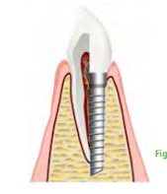
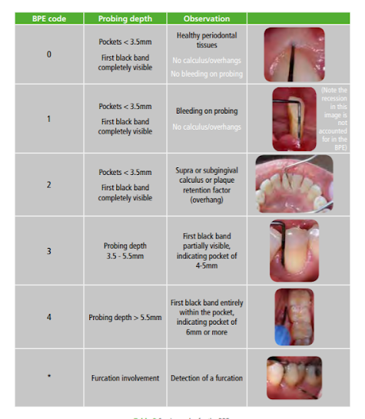
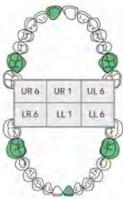
THE BPE
All new patients should have a BPE recorded
Code 0, 1 or 2: BPE should be recorded at every visit
Code 3: initial therapy including self-care advice (OHI and risk factor control) then post initial therapy, a 6-point pocket chart performed in that sextant only
Code 4: if found in any sextant, then a full 6-point pocket chart is required of the entire dentition
Implants: The BPE is not helpful here. For implants, four or six-point pocketing should be done, as well as noting bleeding and suppuration
Periodontal screening for children assesses 6 teeth
(UR6 UR1 LL6 LL1 LR6).
Age 7-11: BPE codes 0-2 used only in mixed dentition phase
Age 12-17: full range of BPE codes can be used

Slide 7
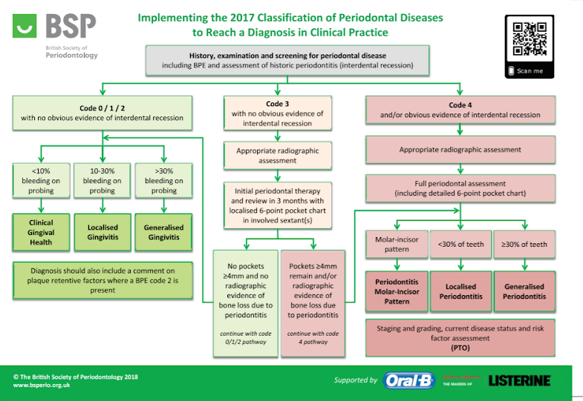

Slide 8
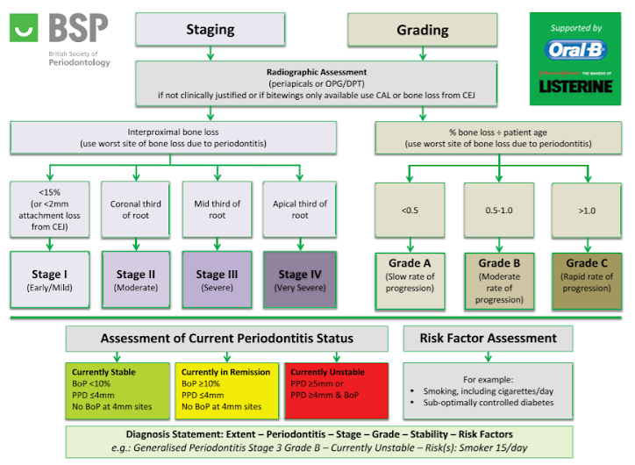

Slide 9
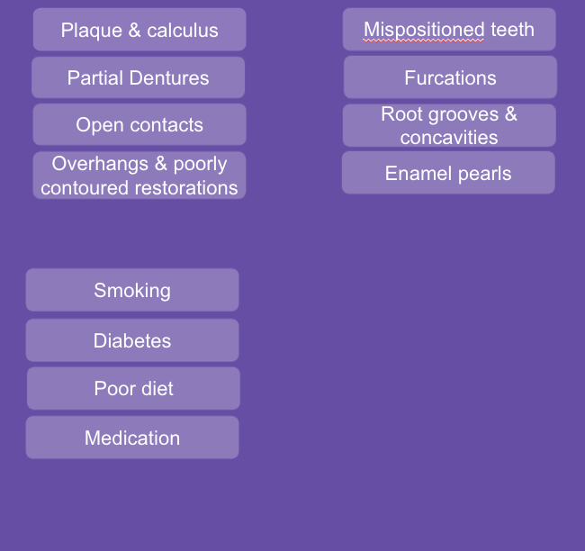
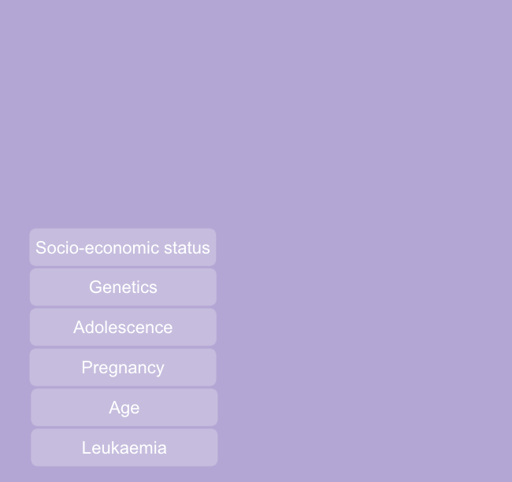
RISK FACTORS
MODIFIABLE FACTORS
NON – MODIFIABLE FACTORS
AQUIRED
ANATOMICAL
After-care instructions
Tender to percussion
LOCAL FACTORS
USO/ LCPA Taken to rule out root fracture treatment
Clinical follow up at 1 week and 6 -8 weeks
Injury to supporting structures without displacement of tooth - but mobility & gingival bleeding present
SYSTEMIC FACTORS

Slide 10
Theory
Considerations
Practical Implementation
1
2
3

Slide 11
WHEN SHOULD I REFER?
After-care instructions
Tender to percussion
COMPLEXITY 1
COMPLEXITY 2
COMPLEXITY 3
USO/ LCPA Taken to rule out root fracture treatment
Clinical follow up at 1 week and 6 -8 weeks
Injury to supporting structures without displacement of tooth - but mobility & gingival bleeding present

Slide 12
Complexity 1
-General Practice-
Diagnosis of periodontal condition, evaluate risk factors, create initial care plan Measure and record periodontal indices
Communicate nature of findings to patient, including risks and outcomes
Design a care plan and provide treatment
Assess patient understanding and willingness to adhere to advice and care plan
Evaluate outcome of periodontal care and provision of a supportive periodontal care program
Continual motivation and risk factor management (e.g. plaque control)
Avoid antibiotic use – unless necrotizing periodontal disease or acute abscess with systemic involvement or advised to by specialist as part of care plan
Preventative and supportive care for patients with implants
Palliative periodontal care and periodontal maintenance

Slide 13
Patients who have stage II, III or IV periodontitis (>30% bone loss) & pocketing >6mm
Grade C periodontitis (as determined by a specialist)
Furcation defects or complex root morphology, when noted by a specialist
Gingival enlargement requiring non-surgical management in collaboration with medical colleagues
Patient who may require pocket reduction surgery as delegated by a specialist
Non-plaque induced periodontal disease (virally-induced, auto-immune diseases, abnormal pigmentation, vesiculo-bullous diseases, periodontal manifestations of gastrointestinal & other systemic diseases)
Peri-implant mucositis
Complexity 2
- GDP or Specialist referral -

Slide 14
Complexity 3
- Referred to specialist -
Usually referred once behavioural risk factors have been addressed and non-surgical treatment undertaken in general practice:
Grade C or Stage IV periodontitis (bone loss >2/3 root length) and true pocketing >6mm
Patients requiring periodontal surgery
Furcation defects and complex root morphologies not suitable for delegation (i.e. to be treated by a specialist)
Non-plaque induced periodontal diseases not suitable for delegation to a practitioner with enhanced skills
Patients requiring multi-disciplinary specialist care (Level 3)
Level 2 complexity patients who don’t respond to treatment
Non-plaque induced periodontal disease (periodontal manifestations of systemic disease) to establish a differential diagnosis, joint care with medical colleagues
Peri-implantitis

Slide 15
Theory
Considerations
Practical Implementation
1
2
3

Slide 16
Motivating Patients
SMOKING
On average it takes 7 attempts to quit smoking
You must ask all patients about their tobacco use
It is your responsibility to ensure patients fully aware of the effects smoking will have on their periodontal health, response to treatment, risk of relapse and eventually risk of tooth loss
This conversation must be had and documented in your records
Current guidance is to refer to a specialist quit smoking service such as NHS Smokefree
If unwilling, you should provide brief cessation advice
Patients should also be warned of transient increase in bleeding gums on cessation as the oral vascular supply returns to normal

Slide 17
CLINICAL RECORDS
Vital to be able to demonstrate from the patient’s records and radiographs that any periodontal disease has been identified and recorded correctly
Records must show that the patient has been informed of the nature and extent of their periodontal disease
If some teeth have a guarded prognosis, this needs to be explained to the patient in a manner that they can understand and recorded in the notes.
Treatment options must be discussed and recorded, this should include the risks, benefits and costs.
The plan going forward must be discussed and documented (e.g. non-surgical therapy, referral or maintenance care)
You must include exactly what hygiene advice you have given; simply noting ‘OHI given’ is not sufficient in the clinical records.

Slide 18
SUPPORT FROM HYGIENIST
Periodontal treatment can be provided by a hygienist or dental hygiene therapist if it is within their scope of practice
It is vital that it is clear to the patient, team and clinical records who is responsible for the care. This may be direct access to a hygienist/therapist or by prescription from a dentist.
If you are responsible for care, you must assess and record the outcome and progress of periodontal treatment at your examinations, even if this is evaluating the work done by the hygienist

Slide 19
RERFERNCES AND FURTHER READING
Smokefree – www.nhs.uk/smokefree
BSP Flowchart Implementing the 2017 Classification, BSP
NHS avoidance of doubt: Provision of phased treatments, BSP
The good practitioners guide to periodontology 2016, BSP
BPE guidelines 2019, BSP
Delivering Better Oral Health: an evidence-based toolkit for prevention, Gov.uk (new update 21st September 2021)

