Slide 1
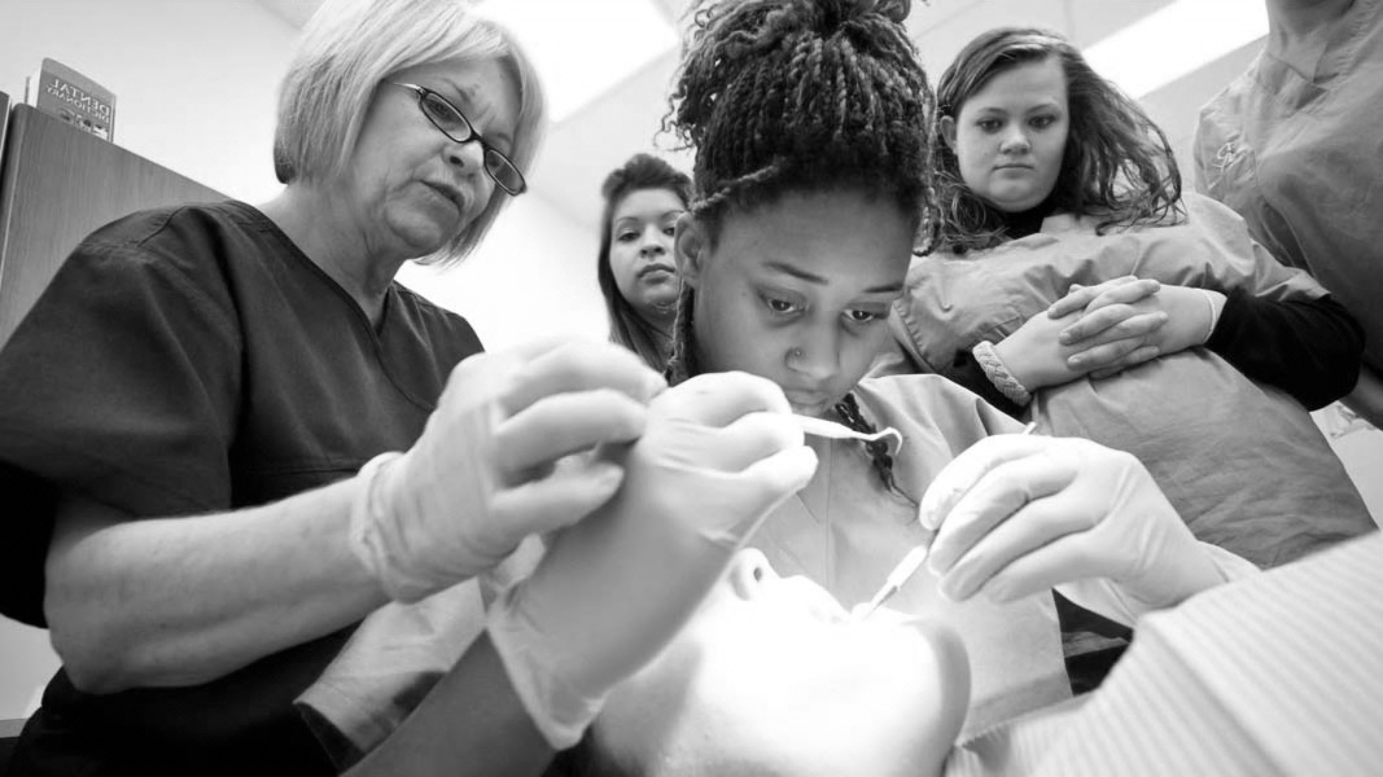

Resin Bonded Bridges BUPA/DTC LEARNING TOOL

Slide 2
GDC OUTCOMES
To be able to communicate reasoning for treatment choice and possible prognosis, while obtaining valid consent.
To work effectively with lab technician, effective communication methods to optimise results.
Understanding theory and practical elements behind the production of a successful RBB.
A
B
C

Slide 3

AIMS AND OBJECTIVES
To understand the indications and contraindications for use of the RBB
To identify factors which may reduce the lifespan of a RBB
To understand material choice when requesting and cementing a RBB
To have adequate knowledge on the literature behind RBB
To be aware of key practical aspects in the production of a successful RBB
To be aware of the limitations of RBB in different scenarios

Slide 4
INTRODUCTION
As cementation materials and protocols improved so did the lifespan of RBBS
As dentistry started to become more minimally invasive the use of the RBB became a
more common treatment choice
A lot of literature over last 10 years showing positive success
Simple templates used to ensure ease of completion for both mentor and delegate
Historically most common reason for failure is debonding , which is why we now see less and less 2 wing RBBs
Case selection is probably the most important factor in the success of a RBB

Slide 5
PROS AND CONS
ADVANTAGES
DISADVANTAGES
Minimally invasive with little or no prep
Good aesthetics
Minimal chair time
Risk of debond with pontic interference
Initial occlusal intereferences
Longevity not as long when compared to conventional bridges
Can only replace short spans
Effectively reversible technique
Little/no damage when they fail
More Cost Effective than other fixed options
Very technique sensitive
Possible shine through of metal wing
Easy to do – if you know what you’re doing!

Slide 6
CASE SELECTION
INDICATIONS
CONTRAINDICATIONS
Minimally restored abutment teeth
Splinting perio compromised, but not when abutments have different mobilities
Single Missing Tooth
Heavily restored abutment teeth
Mal aligned abutment teeth
Patient not willing/ unsuitable for implant procedures
Phobic patients, as les likely to need LA or much drilling
Favourable occlusion- minimal interference for pontic
Minimal enamel surface area for adhesion
Initial occlusal intereferences
Congenitally missing laterals post ortho
High areas of success – replacing anteriors
Base metal allergy eg nickel
Very technique sensitive

Slide 7
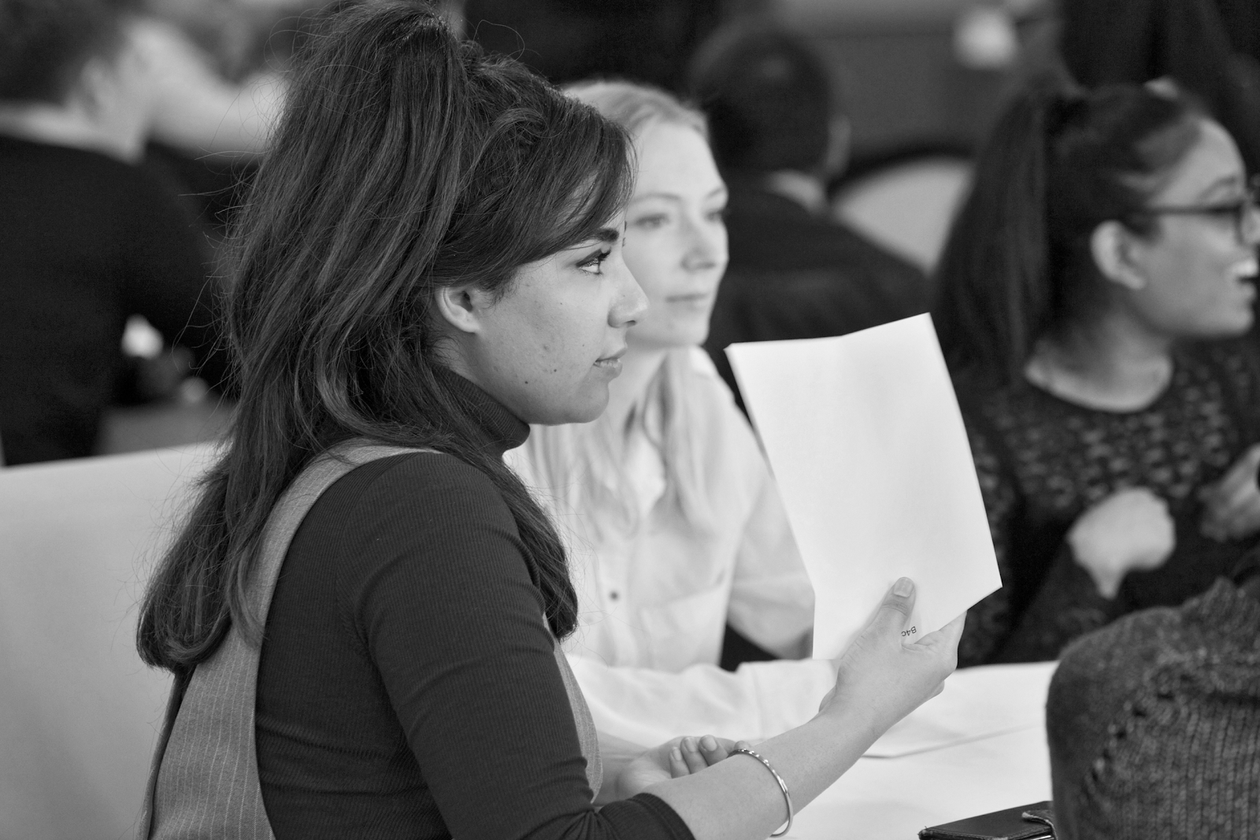
Theory
Considerations
Practical Implementation
1
2
3

Slide 8

DO THEY WORK?
80+% success rate at 15 years
Age of patient did not significantly affect prognosis
Main reason for failure is debond
Most failures occur in first 4 years – 20%
If the bridge surpasses the first 4 years they normally go on to post 15 years of success
Metal wings higher success rate than ceramic

Slide 9
MATERIAL SELECTION
2 main options:
Porcelain fused to Metal
All ceramic
Most data given is based on porcelain fused to metal – good success rate, reliable results
All ceramic is fairly new and data doesn’t go too far back – but shows in general 5 year success
All ceramic is more aesthetically pleasing, but does require more preparation
All ceramic restorations have a very specific cementation protocol that differs from that of Porcelain fused to Metal

Slide 10
Theory
Considerations
Practical Implementation
1
2
3

Slide 11
THE GOLD STANDARD
Porcelain fused to metal
Single abutment single wing
Use of Rubber Dam on cementation
Panavia Opaque
No prep
0.8mm retainer wing thickness
Virgin abutment tooth
Minimum 2mm connector height
Sandblast fit surface
No contact on pontic excursion
If posterior – occlusal coverage
Maximum Palatal coverage

Slide 12
Theory
Considerations
Practical Implementation
1
2
3

Slide 13
PRE-OPERATIVE CHECKS
Decide on whether a RBB is viable in the case, in depth conversation is required to discuss the benefits and negative associated with their use
Assess occlusion to ensure it is possible to ensure no excursion on the pontic
Make patient aware of potential aesthetic concerns
Identify am effective abutment which fits all optimal criteria – eg virgin, large enamel surface area
The following protocol is regarding replacing missing Upper 1s and Missing upper 2s, using porcelain fused to metal
These have been proven to be the most effective and successful RBBs

Slide 14
PREP OR NO PREP
Studies show that prepped abutment teeth show failure twice as much as no prep
Only need for prep is to show lab ideal finish line of wing- this can be done with 0.5mm chamfer prep
No prep is more favourable – need to have good communication with Lab – use of photos marking ideal finish line and good impressions
Make patient aware of occlusal changes and the fact that it can take on average 6 weeks for bridge to ”Dahl” in
Ideally – creat small indent on finish line – but not palatal prep

Slide 15
RETAINER COVERAGE
Need to maximise surface are of enamel to bond to
Cover whole palatal aspect
Ideal bonding with incisal edge overlap – however this compromises aesthetics and is not often used
If using metal wing on Upper 1, can result in clear asymmetry, best to use opaque cement
If replacing Upper 2s , can be more favourable to attach wing to Upper 3 as larger surface area and less likely for wing to shine through

Slide 16
LAB COMMUNICATION
Take relevant impressions and Bite Analysis if required
Pictures help a lot! Especially when showing occlusal interfences dynamic and static, but also to show finish line if you are not prepping it on abutment tooth
Make lab aware of aesthetic concerns – shade, lip line, any character in adjacent teeth you want top replicate

Slide 17
CEMENTATION
Always try in first
If using Opaque cement, dical can replicate this
Ideal cement is Panavia Opaque
Prep tooth prior to cementation
retraction cord/rubber dam isolation
Ultrasonic and bristle brush fit surface
Sandblast fit surface
Prep Wing
Sandblast wing – protect pontic with gauze
Follow instructions of cementation with Panavia

Slide 18
THINGS TO KEEP IN MIND
Case selection is key
There are methods of socket preparation to give an appearance of the pontic coming out of the gum – these are more complex in nature and need much further detail
The success of RBBS is very much dependant on identifying potential pitfalls
Can be used posteriorly, but not as effective

Slide 19
RERFERNCES AND FURTHER READING
Survival characteristics of 771 resin retained bridges provided at a UK dental teaching hospital King et al 2015
Resin Bonded Bridges – the Problem or Solution?
J S Gulati et al 2016
Resin Bonded Bridges: technique for success
Durey et al 2011
Long term survival characteristics of 832 resin retained bridges and splints
Djemal et al 1999
A systematic review of the survival and complications rates of resin bonded bridges
Pjetursson 2008

