Slide 1
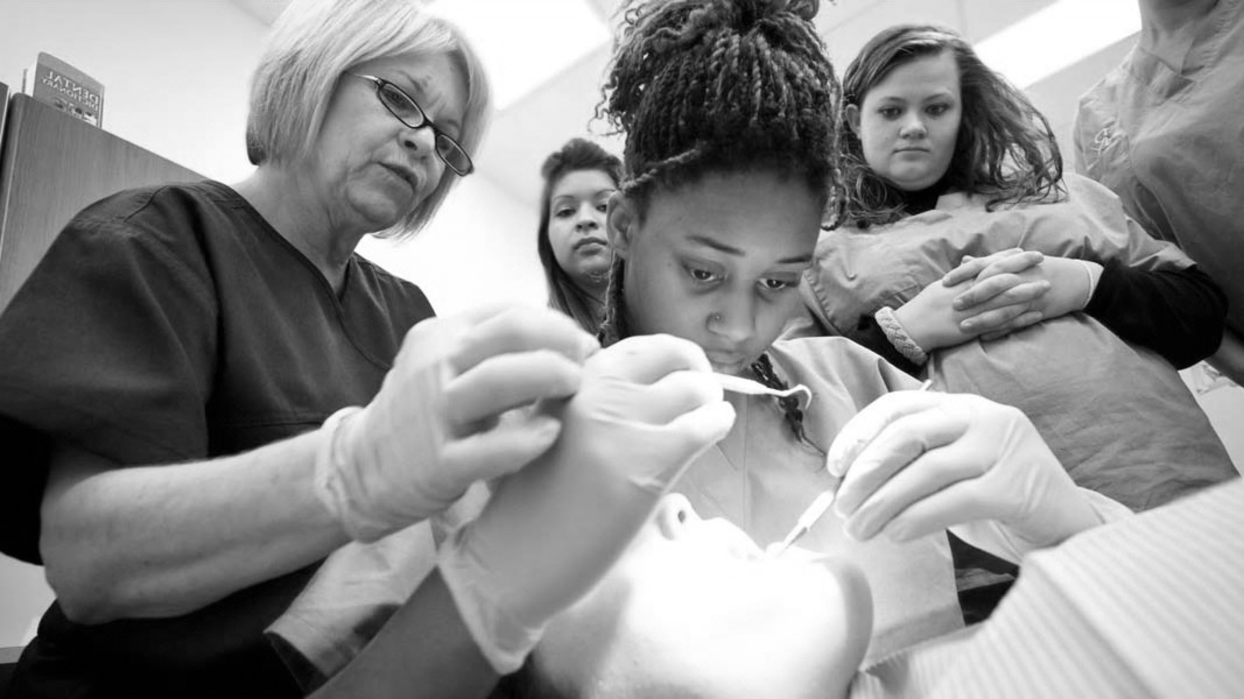

Resin Bonded Bridges BUPA/DTC LEARNING TOOL

Slide 2
GDC OUTCOMES
To be able to communicate reasoning for treatment choice and possible prognosis, while obtaining valid consent.
To work effectively with lab technician, effective communication methods to optimise results.
Understanding theory and practical elements behind the production of a successful RBB.
A
B
C

Slide 3

AIMS AND OBJECTIVES
To understand the indications and contraindications for use of the RBB
To identify factors which may reduce the lifespan of a RBB
To understand material choice when requesting and cementing a RBB
To have adequate knowledge on the literature behind RBB
To be aware of key practical aspects in the production of a successful RBB
To be aware of the limitations of RBB in different scenarios

Slide 4
INTRODUCTION
Historically only used for short interim restorations
As cementation materials and protocols improved so did the lifespan of RBBS
As dentistry started to become more minimally invasive the use of the RBB became a
more common treatment choice
A lot of literature over last 10 years showing positive success
Simple templates used to ensure ease of completion for both mentor and delegate
Historically most common reason for failure is debonding , which is why we now see less and less 2 wing RBBs
Case selection is probably the most important factor in the success of a RBB

Slide 5
PROS AND CONS
ADVANTAGES
DISADVANTAGES
Minimally invasive with little or no prep
Good aesthetics
Minimal chair time
Risk of debond with pontic interference
Initial occlusal intereferences
Longevity not as long when compared to conventional bridges
Can only replace short spans
Effectively reversible technique
Little/no damage when they fail
More Cost Effective than other fixed options
Very technique sensitive
Possible shine through of metal wing
Easy to do – if you know what you’re doing!

Slide 6
CASE SELECTION
INDICATIONS
CONTRAINDICATIONS
Minimally restored abutment teeth
Splinting perio compromised, but not when abutments have different mobilities
Single Missing Tooth
Heavily restored abutment teeth
Mal aligned abutment teeth
Patient not willing/ unsuitable for implant procedures
Phobic patients, as les likely to need LA or much drilling
Favourable occlusion- minimal interference for pontic
Minimal enamel surface area for adhesion
Initial occlusal intereferences
Congenitally missing laterals post ortho
High areas of success – replacing anteriors
Base metal allergy eg nickel
Very technique sensitive

Slide 7

Theory
Considerations
Practical Implementation
1
2
3

Slide 8

DO THEY WORK?
80+% success rate at 15 years
Age of patient did not significantly affect prognosis
Main reason for failure is debond
Most failures occur in first 4 years – 20%
If the bridge surpasses the first 4 years they normally go on to post 15 years of success
Radiographs

Slide 9
IMPORTANT CONSIDERATIONS
Thorough history should be taken and where appropriate refer for medical assessment
Safeguarding concerns?
Children may be quite anxious, and following acute management, consider referral to specialist services that have access to Sedation/General anaesthesia if required
Sensibility testing usually unreliable in primary dentition
After-care instructions:
Soft diet
Gentle, but thorough oral hygiene
Application of Chlorhexidine 0.12% topically twice daily for 1-2 weeks
Parents should be aware of signs of infection

Slide 10
EXTRUSION
Partial displacement of the tooth out of the socket
USO and LCPA Taken
Treatment
If <3mm and not interfering with occlusion can allow it to spontaneously reposition
If >3mm and not interfering with occlusion— can reposition if child cooperative- see Dental Trauma Guide for technique
Follow up at 1 week, 6-8 weeks and 1 year
If interfering with occlusion or severe extrusion/ mobility - extract
LATERAL LUXATION
Tooth displaced in a direction other than axially - palatally/labially
Tooth usually not mobile
USO and LCPA Taken
Treatment
If not affecting occlusion and not severe - spontaneous repositioning
In severe protrusion - extract- because risk of damage to the permanent tooth germ
Retrusion that does not affect occlusion - allow spontaneous repositioning
Retrusion that is affecting occlusion - can reposition if child cooperative
Follow up 1 week, 6-8 weeks, 6 months , 1 year
After-care instructions
Tender to percussion
USO/ LCPA Taken to rule out root fracture treatment
Clinical follow up at 1 week and 6 -8 weeks
Injury to supporting structures without displacement of tooth - but mobility & gingival bleeding present

Slide 11
INTRUSION
Displacement of tooth into the socket
In severe cases tooth looks avulsed
USO/ LCPA
Treatment
Tooth should be allowed to re-erupt
After-care
Clinical review at 1 week
Clinical & radiographic follow up at 3-4 weeks, 6-8 weeks, 6 months and 1 year
Parents should be warned of risk of damage to permanent tooth, esp if child <3 yrs.
AVULSION
Ensure lost tooth is accounted for
If not - may need to refer to medics due to risk of aspiration
Tooth is not replanted
After-care instructions
Monitor eruption of permanent successor
After-care instructions
Tender to percussion
USO/ LCPA Taken to rule out root fracture treatment
Clinical follow up at 1 week and 6 -8 weeks
Injury to supporting structures without displacement of tooth - but mobility & gingival bleeding present

Slide 12
HARD TISSUE INJURIES
INFRACTION - incomplete fracture in enamel - no treatment necessary
ENAMEL FRACTURE - Treatment: smooth sharp edges, check for fragments of tooth in soft tissue, soft diet, good oral hygiene, no follow up needed
ENAMEL-DENTINE FRACTURE - Baseline radiograph optional; Treatment: clean area with saline, restore with glass ionomer/ composite, instructions to parents, follow up at 6-8 weeks
ENAMEL-DENTINE-PULP FRACTURE - Baseline radiograph; Treatment: Pulp capping/ Partial pulpotomy (see Dental Trauma Guide) depending on child’s cooperation, or extraction

Slide 13
CROWN-ROOT FRACTURE WITHOUT PULP INVOLVEMENT
USO/ LCPA Taken
Treatment
Extraction/ Removal of the fractured segment and restoration in glass ionomer/ composite
After-care instructions
Follow up 1 week, 6-8 weeks, 1 year
Radiographs after 1 year
CROWN-ROOT FRACTURE WITH PULP INVOLVEMENT
USO/ LCPA Taken
Treatment
Extraction/ Removal of the fractured segment, pulpectomy and restoration
After-care instructions
Follow up 1 week, 6-8 weeks, 1 year
Radiographs after 1 year

Slide 14
ROOT FRACTURE
USO/ LCPA Taken
Treatment
No treatment required if - coronal fragment is not displaced/ slightly displaced without excessive mobility
If excessively displaced/ mobile/ interfering with occlusion - reposition (see Dental Trauma Guide) follow up 1 week, 4 weeks, 8 weeks and 1 year
Or extract (only the coronal segment, apical portion will resorb)
ALVEOLAR FRACTURE
USO/LCPA Taken
Teeth will be mobile as a unit
Root fractures may be present
Treatment
Often requires GA to reposition and a flexible splint for 4 weeks
After care instructions
Clinical review at 1 week, 4 weeks, 8 weeks and 1 year
Radiographs at 4 weeks and 1 year

Slide 15
COMPLICATIONS
Pulp necrosis - Grayish discolouration can occur immediately after an injury - sign of intra-pupal bleeding - and may subside on follow up. If this persists - tooth may be necrotic.
Pulp canal may become obliterated following trauma - can be seen on radiograph. Crown may appear more yellow. Usually tooth can be retained until exfoliation.
Root resorption may occur - internal/ external. Treatment is extraction. Ankylosis can occur after intrusion injuries.
Damage to permanent dentition - including malformation,impaction and delayed eruption can occur, most commonly following avulsion and intrusion injuries

Slide 16
Primary Dentition
Permanent Dentition
Considerations
1
2
3

Slide 17
PERIODONTAL INJURIES
CONCUSSION
Injury to the periodontal tissues without mobility or displacement
Tender to percussion
Take LCPA at baseline
Treatment
After-care
Clinical and radiographic follow up at 4 weeks and 1 year
SUBLUXATION
Injury to the periodontal tissues with mobility but no displacement
Tender to percussion
Take LCPA and USO at baseline
Pulp may or may not be responsive to sensibility test initially
Treatment
Can splint for up to 2 weeks (flexible)
After-care
Clinical and radiographic follow up at 2 weeks, 12 weeks, 6 months and 1 year

Slide 18
EXTRUSION
Partial displacement of the tooth out of the socket
USO and LCPA Taken, & 2 eccentric views
Usually lack of response to sensibility testing unless minor displacement
Treatment
Reposition (see Dental Trauma Guide)
Flexible splint for 2 weeks, (+4 weeks if alveolar bone fracture)
After care
Follow up clinically and radiographically at 4 weeks, 8 weeks, 12 weeks, 6 months, 1 year and yearly for 5 years
High risk of pulp necrosis if apex is mature, better prognosis is immature
LATERAL LUXATION
Tooth displaced in a direction other than axially - palatally/labially
Tooth usually not mobile
USO and LCPA Taken, & 2 eccentric views
Usually lack of response to sensibility testing unless minor displacement
Treatment
Reposition (see Dental Trauma Guide)
Flexible splint for 4 weeks (+ 4 weeks if alveolar bone fracture)
After care
Follow up clinically and radiographically at 4 weeks, 8 weeks, 12 weeks, 6 months, 1 year and yearly for 5 years
High risk of pulp necrosis if apex is mature, better prognosis is immature

Slide 19
INTRUSION
Displacement of tooth into the socket
In severe cases tooth looks avulsed
USO, LCPA & 2 eccentric radiographs
Treatment
Immature apex:
allow spontaneous re-eruption. If no movement in 4 weeks - orthodontic repositioning
Monitor pulp - may require RCT
Mature apex:
allow spontaneous re-eruption if <3mm, if no movement in 4 weeks reposition (surgically/ orthodontically) splint for 2 weeks; if 3-7mm reposition surgically/ orthodontically, if >7mm reposition surgically and splint. Will require RCT in 2 weeks

Slide 20
If a tooth is avulsed, make sure it is a permanent tooth
Keep the patient calm
Find the tooth and pick it up by the crown (the white part).
Avoid touching the root.
If the tooth is dirty, rinse it gently in milk, saline or in the patient’s saliva and encourage the patient/parent to replant the tooth in the original position in the jaw.
Bite on a handkerchief to hold the replanted tooth in position.
If immediate replantation is not possible, place the tooth in a suitable storage medium available eg milk, saliva, saline. This should be done quickly to avoid dehydration of the root surface. Although water is a poor medium, it is better than leaving the tooth to air-dry.
Seek emergency dental treatment immediately.
AVULSION: EMERGENCY INSTRUCTIONS
(DENTAL TRAUMA GUIDE)

Slide 21
OPEN APEX
TREATMENT:
If the avulsed tooth has been in contact with soil and if tetanus coverage is uncertain, refer for tetanus booster.
There is a possiblity for revascularisation of the tooth pulp. If that does not occur, refer to specialist for apexification, pulp revitalisation/revascularisation
After-care Instructions
Avoid participation in contact sports
Soft food for 2 weeks
Brush teeth with a soft toothbrush after each meal
Use a chlorhexidine (0.12%) mouth rinse twice a day for 1 week
If the both has been replanted, leave the tooth in place
Give LA & clean the area with water, saline or chlorhexidine
Suture any gingival lacerations
Verify normal position of the replanted tooth both clinically and radiographically
Flexible splint for 2 weeks
Prescribe antibiotics for 7 days

Slide 22
OPEN APEX
If the extra-oral dry time is < 60 minutes
Clean the tooth with saline, suture gingivae, flexible splint, radiograph & antibiotics
Follow up to remove splint at 2 weeks, clinical ad radiographic follow up at 4 weeks, 3 months, 6 months, 1 year and yearly
Only begin RCT if signs of necrosis
If the extra-oral dry time is > 60 minutes
Follow the procedure as above
Poor prognosis - high risk of ankylosis & resorption, but it can act as a space maintainer and keeps other treatment options available

Slide 23
CLOSED APEX
TREATMENT:
Follow the procedures as for open apex
Root canal treatment within 2 weeks after replantation
Initiate RCT whilst splint in place, dress with calcium hydroxide for up to 1 month prior to obdurating
Alternatively an antibiotic-corticosteroid paste may be placed immediately or shortly after replantation and left for at least 2 weeks
Clinical review and radiographs at 4 weeks, 3 months, 6 months, 1 year and then yearly for at least 5 years
Prognosis is poor if extra-oral dry time over 60 minutes

Slide 24
HARD TISSUE INJURIES
INFRACTION - incomplete fracture in enamel - if marked, can etch and seal, if minor no treatment needed
ENAMEL FRACTURE - LCPA .Treatment: smooth sharp edges or restore in composite, check for fragments of tooth in soft tissue, soft diet, good oral hygiene, follow up clinical and radiographically at 6-8 weeks and 1 year
ENAMEL-DENTINE FRACTURE - LCPA, Treatment: clean area with saline, can bond the fragment if available - see Dental Trauma Guide, soft diet, good oral hygiene, follow up clinical and radiographically at 6-8 weeks and 1 year

Slide 25
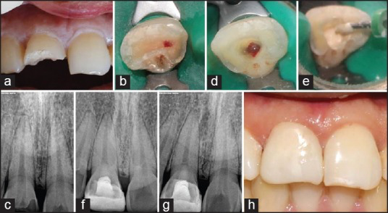
HARD TISSUE INJURIES
ENAMEL-DENTINE-PULP FRACTURE - LCPA,
Treatment:
Aim for open apex is to maintain vitality to allow apexogenesis
For both Immature/Mature Apices:
Clean area with saline, direct pulp-capping and restore, or Partial Pulpotomy “Cvek” (2-3mm of pulp tissue removed with haemostasis) and restore.
If closed apex with associated luxation - likely will need RCT.
Follow up clinically and radiographically at 6-8 weeks, 3 months, 6 months and 1 year
When using coarse diamond burs to remove enamel be careful not to apply too much pressure- as can cause cracks in enamel surface
NB. g. 18 month follow up. Borkar, S., & Ataide, I. (2015). Biodentine pulpotomy several days after pulp exposure: Four case reports. Journal of Conservative Dentistry,

Slide 26
CROWN-ROOT FRACTURE, WITH PULP INVOLVEMENT
USO, LCPA, 2 Eccentric views
Treatment
Immediate treatment : temporarily stabilise mobile fragment against adjacent teeth
If open apex - pulp-capping/ partial pulpotomy
Various methods of treatment - referral for gingivectomy, surgical/ orthodontic extrusion, coronectomy; extraction
After-care
CROWN-ROOT FRACTURE, WITHOUT PULP INVOLVEMENT
USO, LCPA, 2 Eccentric views
Treatment
Can Remove Coronal fragment only and restore if superficial
Various methods of treatment - referral for gingivectomy, surgical/ orthodontic extrusion, coronectomy; extraction
After-care

Slide 27
ROOT FRACTURE | ROOT FRACTURE
LCPA, USO 2 eccentric views | USO, LCPA and eccentric views
If coronal portion has avulsed - follow guidelines for avulsion | Teeth will be mobile as a unit
Otherwise - reposition, check with radiograph, flexible splint for 4 weeks - if fracture in cervical third flexible splint for up to 4 months | Root fractures may be present Treatment
Monitor pulp, if pulp necrotic then RCT up to fracture line | Clean, reposition and flexible splint for 4 weeks
Clinical and radiographic review at 4 weeks, 6-8 weeks, 6 months, 1 year, yearly for 5 years | After care instructions
 | Monitor vitality of teeth in the fracture line - initiate RCT if required
 | Clinical & radiographic review at 6-8 weeks, 4 months, 6 months, 1 year and yearly for 5 years

Slide 28
Primary Dentition
Permanent Dentition
Considerations
1
2
3

Slide 29
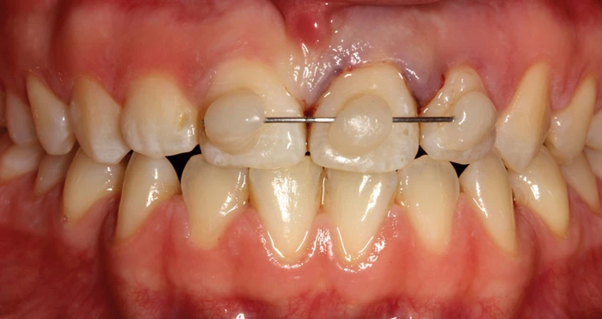
FLEXIBLE SPLINT
Types of splints available:
Composite and wire splint, most commonly used, wire should be up to 0.4mm in diameter to be flexible
Orthodontic wire and bracket; Fibre splints - usually a polyethylene or Kevlar fibre; Arch bar splints; Wire ligature splints; Composite splints (rigid - not recommended) ; Vacuum formed removable splints - requires impression taking and preparation of models but useful where adjacent teeth are unerupted
Tagar, H., & Djemal, S. (2017). Oral surgery II: Part 1. Acute management of dentoalveolar trauma. British Dental Journal

Slide 30
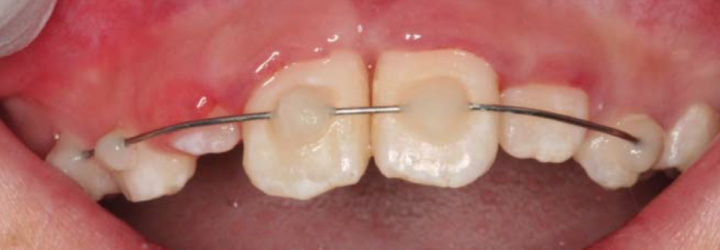
Tips for Composite & Wire Splint:
Use a darker shade of composite - easier to remove
Place composite away from gingival margins and embrasure space to maintain oral hygiene
Isolate
Etch & bond
Apply base composite and cure , position pre-curved wire, place composite over it and cure - uninjured teeth first, check position of injured tooth and place composite
When removing use Tungsten carbide bur and soflex discs
Leith R O'Connell AC, Top tips for splinting traumatised teeth, Journal of the Irish dental association
Note - partially erupted laterals are not included

Slide 31
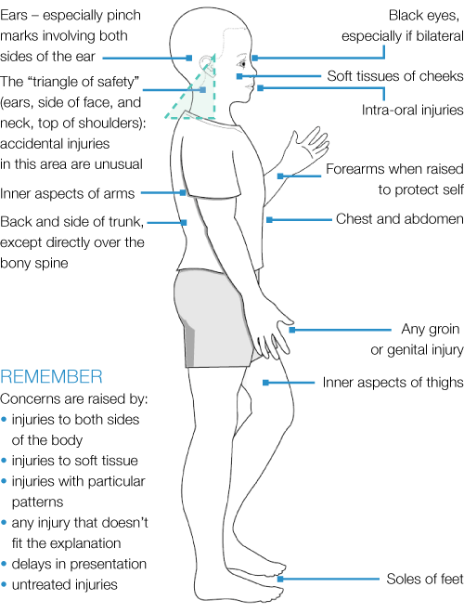
NON-ACCIDENTAL INJURY
Studies have shown that as many as 50-75% of all cases of child abuse involve trauma to the mouth, face and head
Types of injury: bruising, burns, bite marks, eye injuries, bone fractures, abrasions and lacerations, intra-oral injuries
Pay close attention to the child’s behaviour, and interaction with parents
Has there been a delay in seeking treatment? Does the history match the injuries?
If concerned, follow your local safeguarding protocol
Consent for referral, except in certain circumstances…
https://bda.org/childprotection/Recognising/Pages/Physical.aspx

Slide 32
RERFERNCES AND FURTHER READING
British Dental Association (2021). Child protection and the dental team:[online]. Available from: https://bda.org/childprotection
Borkar, S., & Ataide, I. (2015). Biodentine pulpotomy several days after pulp exposure: Four case reports. Journal of Conservative Dentistry, 18(1), 73. https://doi.org/10.4103/0972-0707.148901
Cvek M. (1978). A clinical report on partial pulpotomy and capping with calcium hydroxide in permanent incisors with complicated crown fracture. Journal of endodontics, 4(8), 232–237. https://doi.org/10.1016/S0099-2399(78)80153-8
International Association for Dental Traumatology. Guidelines for the evaluation and management of traumatic dental injuries. Available from: https://www.iadt- dentaltrauma.org/for-professionals.html
Leith, R., O'Connell, A.C. (2017). Top tips for splinting traumatised teeth, Journal of the Irish dental association, 63, (5), p260 – 262
Tagar, H., & Djemal, S. (2017). Oral surgery II: Part 1. Acute management of dentoalveolar trauma. British Dental Journal, 223(6), 407–416. https://doi.org/10.1038/sj.bdj.2017.805
Todd, S. (2020). How flexible is your trauma splint? BDJ Student, 27(3), 50. https://doi.org/10.1038/s41406-020-0145-7
University of Copenhagen and International Association for Dental Traumatology. Dental Trauma Guide. dentaltraumaguide.org/(now subscription based)

