Slide 1
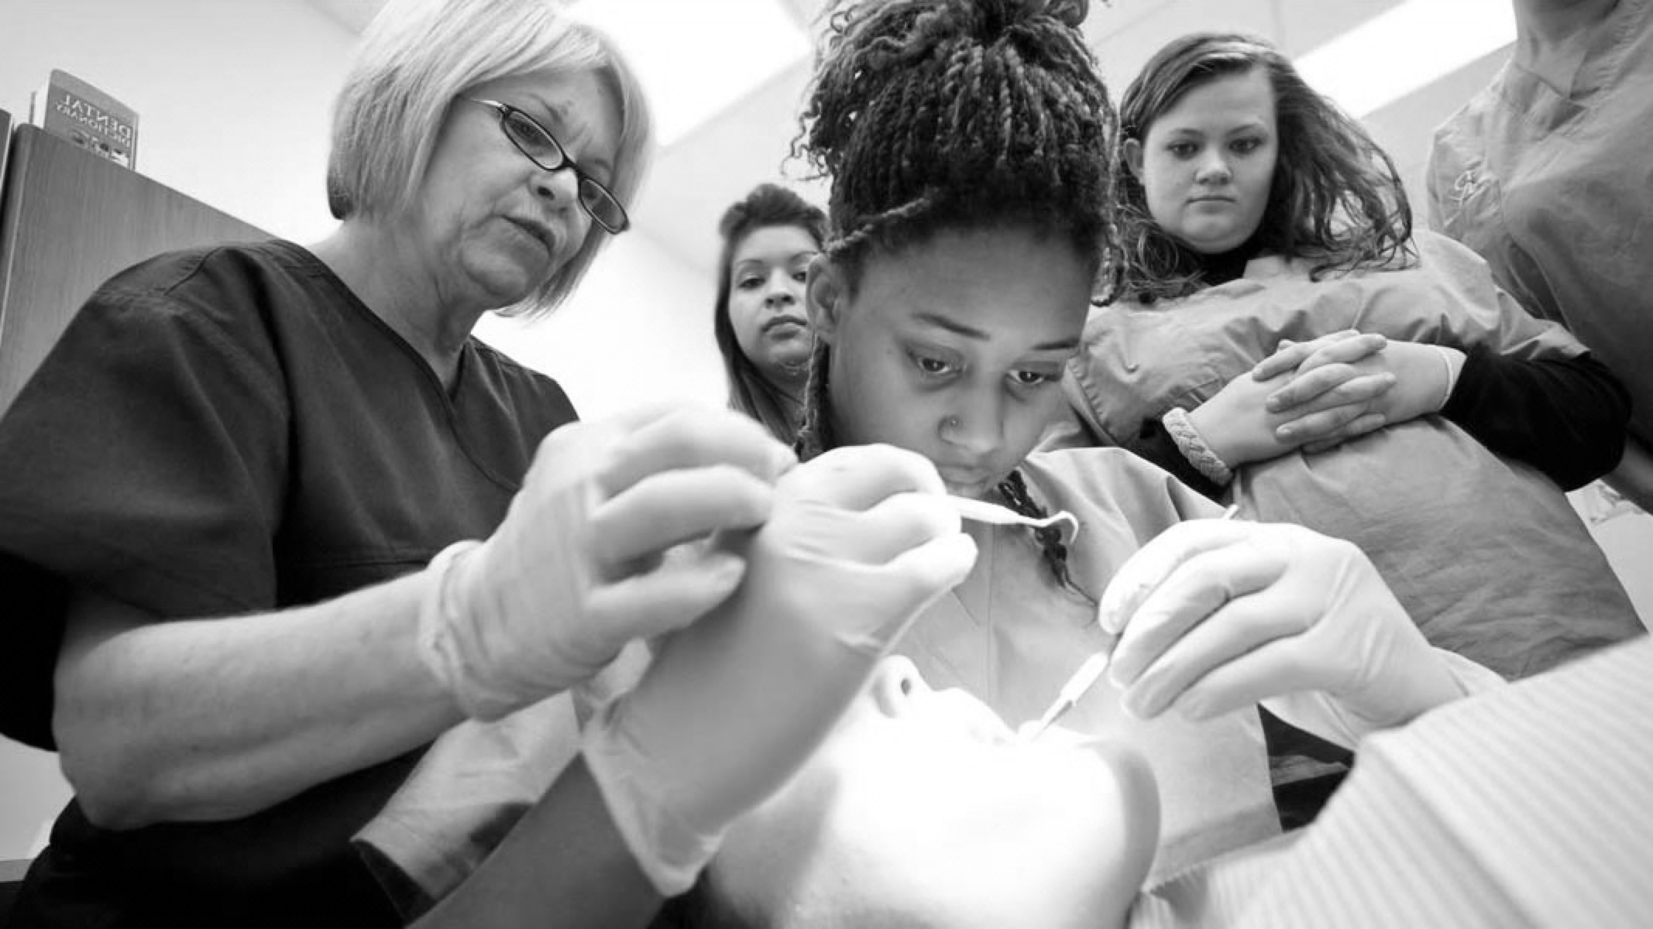

Vaneers Contents: GDC outcomes Aims and Objectives Introductions Theory Practical Element Further Reading

Slide 2

GDC OUTCOMES
To be able to communicate reasoning for treatment choice and possible prognosis, while obtaining valid consent ​
To work effectively with lab technician, effective communication methods to optimise results​
Understanding theory and practical elements behind the production of Vaneers
A
B
C

Slide 3
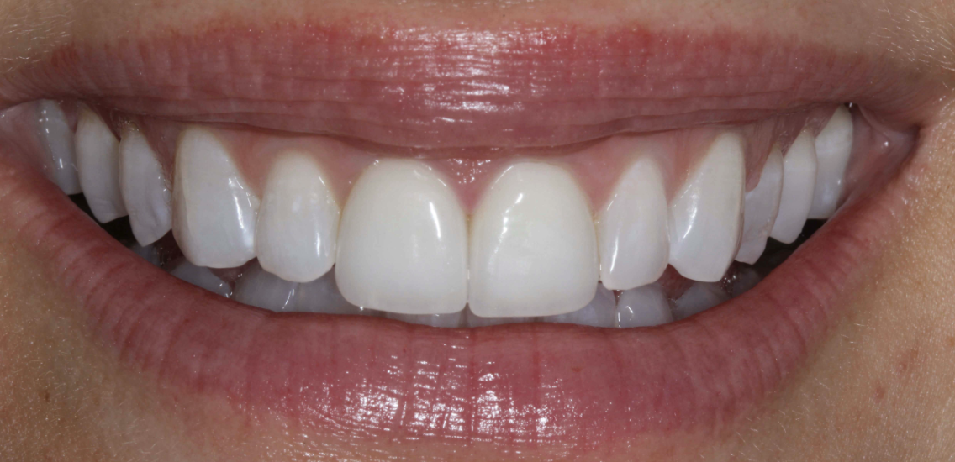
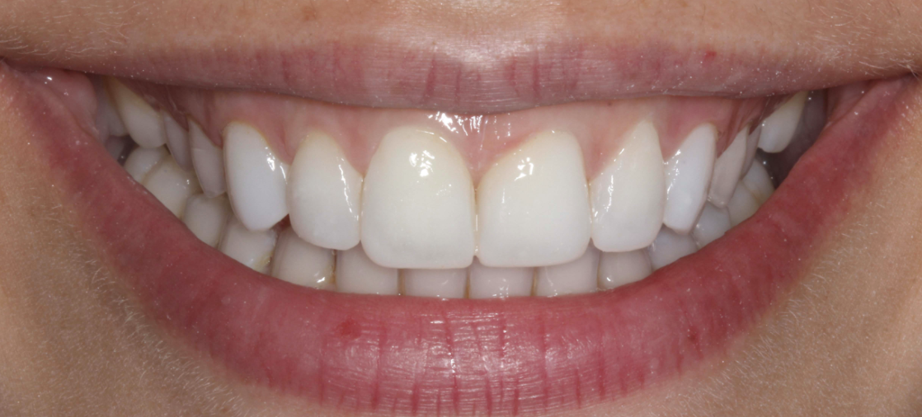
INTRODUCTION
Dental Veneers are shells of usually porcelain and sometimes composite that are tooth coloured materials that cover the buccal surface of the teeth.
Lab-fabricated
CAD-CAM milled
PORCELAIN VANEER
Lab-made
Direct built in mouth
COMPOSITE VANEER

Slide 4

INDICATIONS
Closing Spaces (Diastema closures)
Minor tooth position improvements
Lengthening worn teeth and improving shape
Improving aesthetics
Stained teeth due to intrinsic and extrinsic staining
Enamel hypoplasia
Anatomically malformed teeth

Slide 5

CONTRAINDICATIONS
Crowded teeth
Lack of enamel
Para-functional habits
Non-ideal occlusion
Periodontal disease
Poor Oral hygiene
Patient with high expectations
Large Diastema

Slide 6
PORECLAIN VANEERS
ADVANTAGES
DISADVANTAGES
High Aesthetics
Gingival Health
More Expensive
not suitable for para-functional habit patients
technique sensitive
Stain resistant
Low maintenance
More Costly than composite Vaneers
not repairable if chip or break
likely to involve preparation of the tooth
Strong and Durable
Can Prevent tooth discoloration
irreversible
they can fall off

Slide 7
COMPOSITE VANEERS
ADVANTAGES
DISADVANTAGES
Tend to discolour with time
Aesthetics not as good as porcelain
Usually one visit
minimal preparation of tooth compared to porcelain
Less Durable
Less Expensive that porcelain
can be repaired
Marginal staining
often require repair

Slide 8
PLANNING
PATIENT EXPECTATIONS:
This is really important.
We must figure out what exactly the patient desired outcome is. Vaneers are irreversible and so once you commit there is no going back. This means we have to understand very clearly with documentation what the patient desired are.
Then we will establish if we can achieve that using our skills otherwise DO NOT DO IT!
Always : “Under promise and over deliver”
ORAL HEALTH:
It is imperative that oral health is peak before starting. This means good Oral hygiene, Caries free, Perio free and orthodontically stable
ALTERNATIVES:
Are there any alternatives less invasive options? Whitening? Orthodontics?

Slide 9
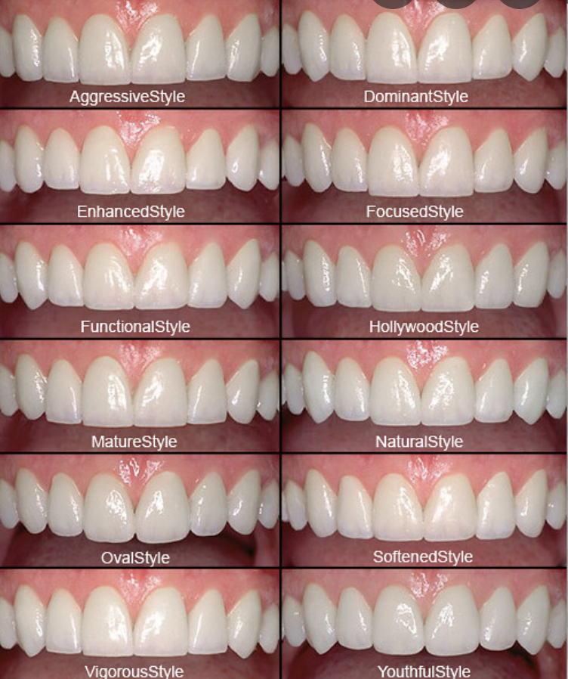
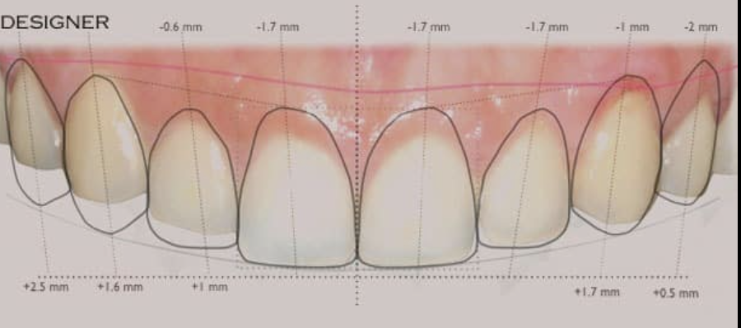
PLANNING 2
SMILE DESIGN
Use Principles of Smile design to aid design of new vaneers
Things to consider:
Face
Lips
Teeth (shape)
Gingiva (aesthetics, disease, biotype, width
Shade

Slide 10
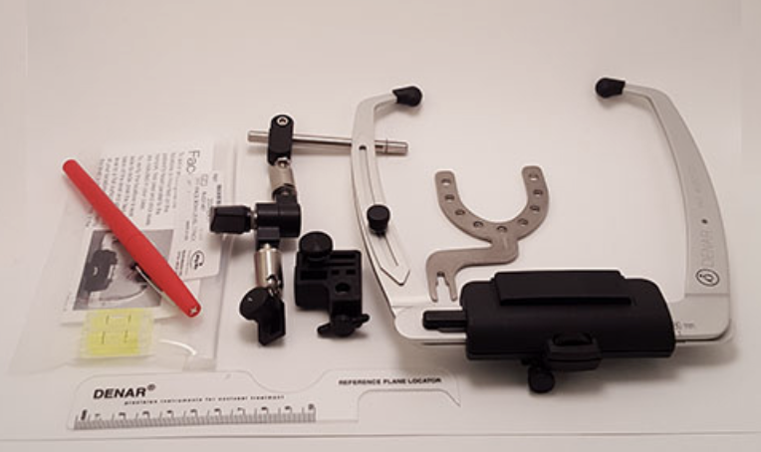
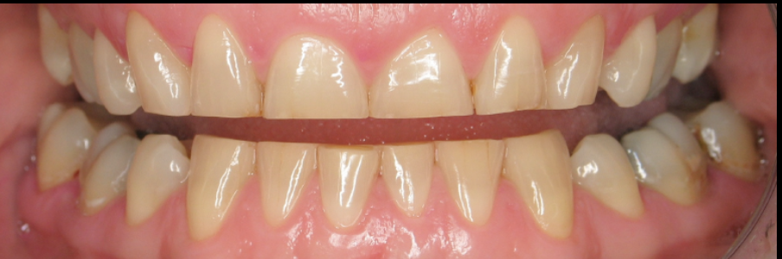
PLANNING 3
OCCLUSION:
Analysis of Occlusion is very important for success
Key Points:
1.Identify high risk (parafunctional patients)
2. Assess impact of occlusion on vaneers
3. Record Occlusion in ICP and also in dynamic movements
4. Trans information of occlusion to lab (FACEBOW)
CLINICAL PHOTOS:
Full set of clinical photos required including face
Video of occlusion helpful for lab and for planning

Slide 11
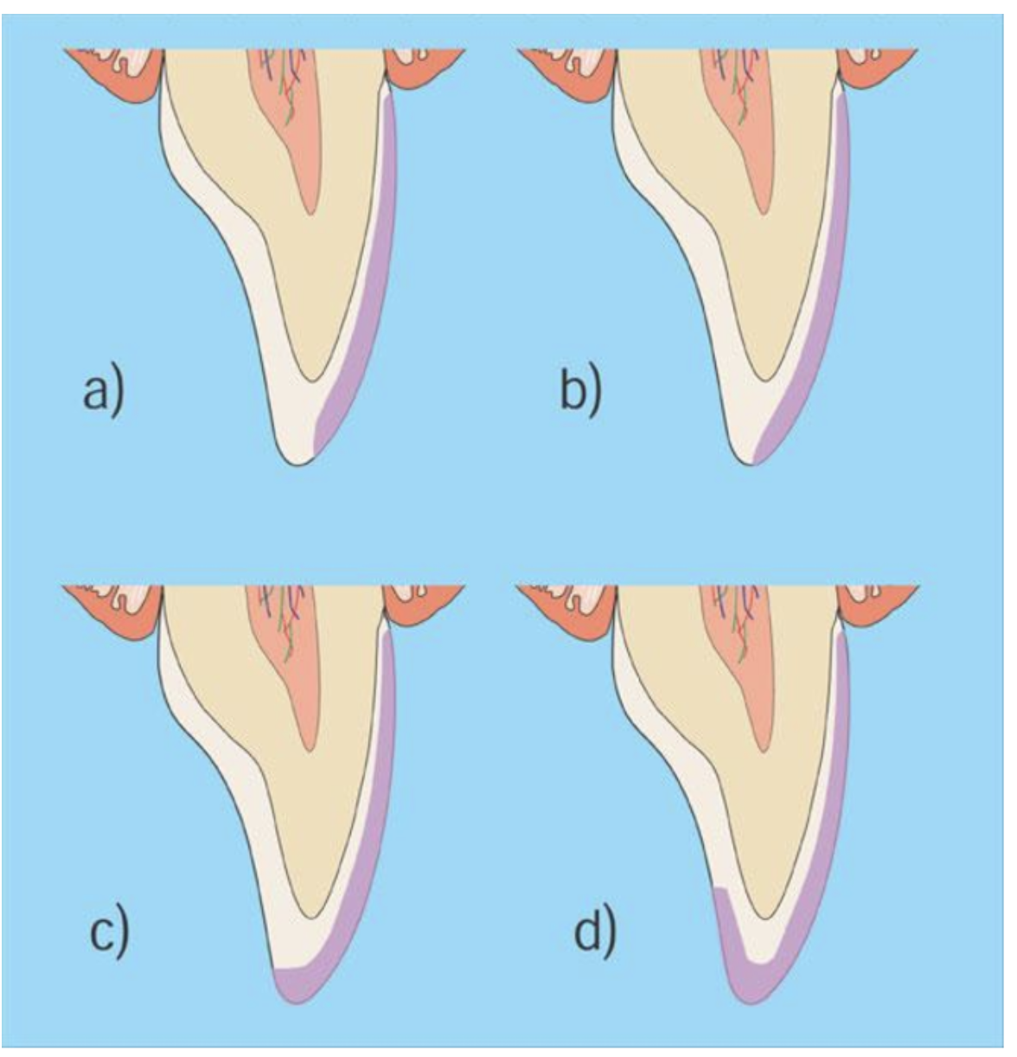
PREP DESIGN
Prep Design:
Window:
Most conservative,
Least Aesthetic
Feather Edge:
Highly conservative and not in occlusion
No translucency at edge
Butt-Joint:
1.1.5mm edge reduction
Highly aesthetic and allows for translucency
Chamfer:
Less conservative and difficult to prep and manufacture however good fracture resistance

Slide 12
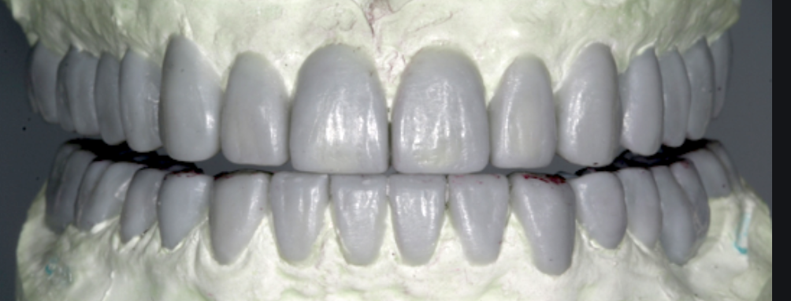
A good diagnostic Wax-up is key to success:
Can show patient example of final result in the mouth (will this meet their demands?)
Have you achieved the smile design proposed?
Check Occlusion
Used to made guide for preparation
Used to make temporary restoration
WAX UP

Slide 13
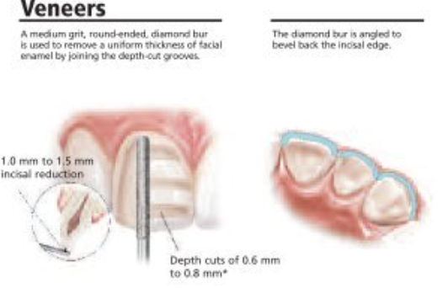
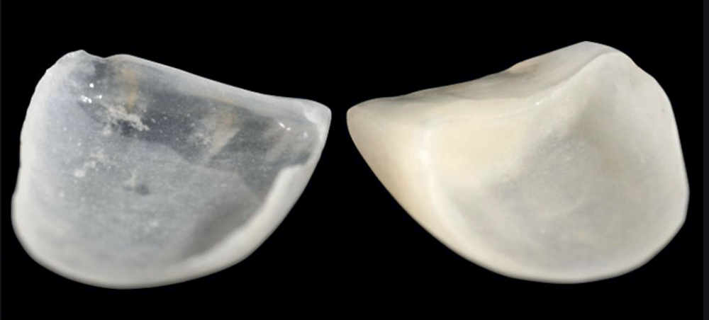
MATERIALS AND PREP
Most commonly used materials for porcelain vaneers:
0.3-1mm reduction
Good balance between strength vs aesthetics
Emax (lithium Disilicate)
(pressed or milled)
Feldspathic porcelain
Best Aesthetics
Not as strong as Emax

Slide 14
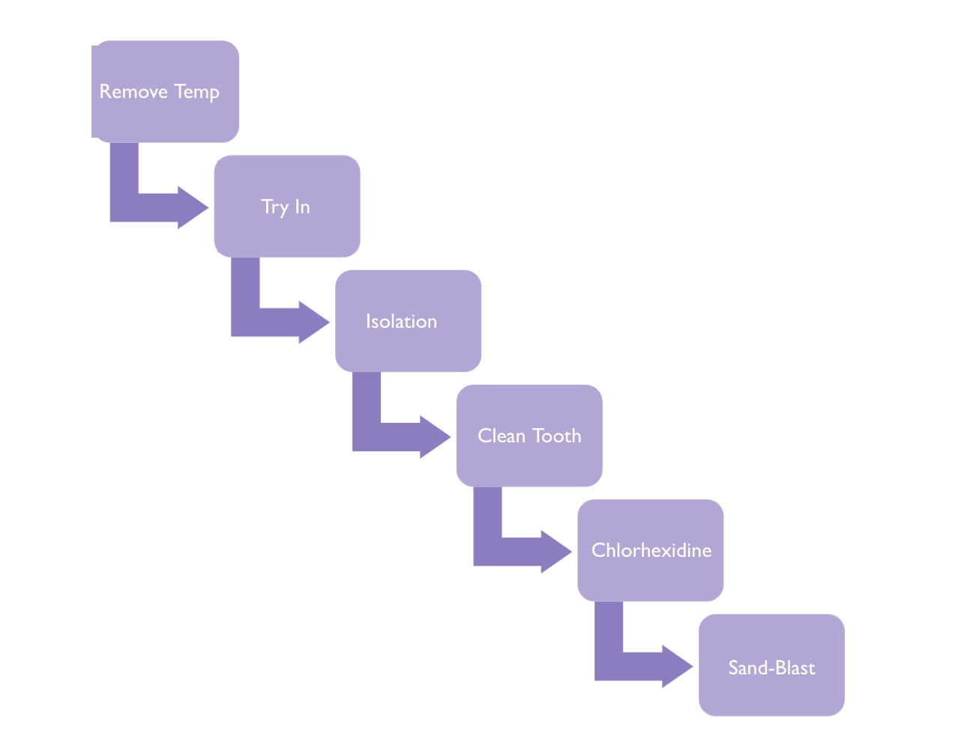
CEMENTATION – TOOTH PREP
Check Fit / Margin / Contact (Try-in Paste)
Rubber Dam (split dam good for this)
Pumice or ultrasonic
60 Sec rinse
27 Micron Aluminium Oxide

Slide 15
GOLD NON-PRECIOUS:
Sand blask
27µ Aluminium Oxide
CEMENTATION 2 – VANEER PREP
EMAX / FELDSPATHIC:
Etch
9.6% hydrofluoric Acid,
10-20 Secs
Silane
2 layers
Apply and Dry

Slide 16
CEMENTATION 3
Isolate Adjacent teeth (PTPE Tape )
Etch Tooth Surface
Apply Primer
Apply Resin Bond (DO NOT CURE!)
Place Resin Cement on vaneer
Place Vaneer
Cure 5-seconds then remove excess
Final Cure
Polish

Slide 17
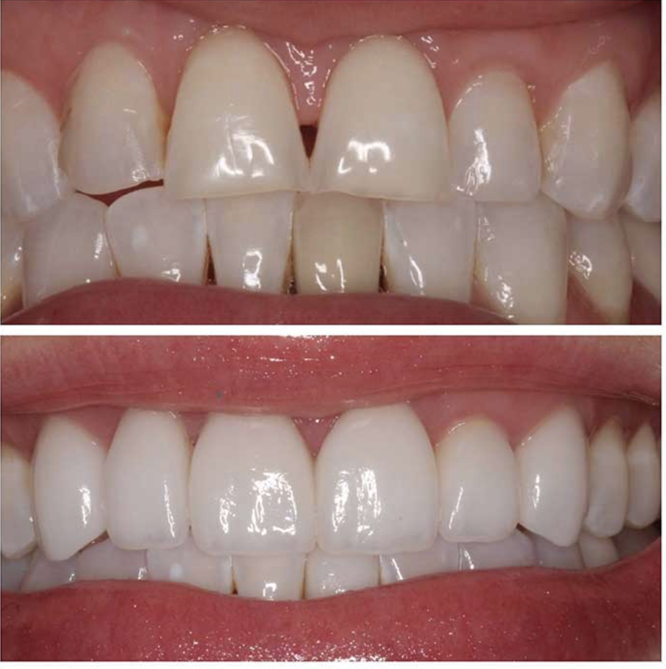
FINISHING
Post-cementation:
Check Occlusion
Ensure all cement has gone.
Reinforce OHI
Post-op review:
Photos
Check gingivae for any excess cement
Check and reinforce Oral hygiene
Check occlusion again!

Slide 18
FURTHER READING
Biomimetic Restorative Dentistry Vol 1
Magne, Pascal / Belser, Urs C
Bonded Porcelain Restorations in the Anterior Dentition
Magne, Pascal / Belser, Urs C
Inside Dentistry, November 2012, Volume 8, Issue 11
An Overview of Permanent Cements
What a general practitioner needs to know to select the appropriate dental cement.
By Mojdeh Dehghan et al

